Slide 1
THE POWER OF PRINT IN A DIGITAL WORLD
John Kirchner
Alphagraphics – Aurora, IL
630-453-7230

Slide 2
John Kirchner – Alphagraphics Aurora, IL
Marketing executive for 25+ years
Last 12 years with Alphagraphics focused on print and direct mail sales
Previously worked in digital media sales, primarily CD/DVD/web
Before that I worked for a company that scanned paper to digital. Seen it all!

Slide 3
Introduction
“These have changed the whole face and state of things throughout the world: printing, gunpowder, and the mariner’s needle.”
- Sir Francis Bacon, 1620

Slide 4
Changing the World
In 1436, Johannes Gutenberg invented the printing press.
This invention seemingly transforms the world, bringing humanity out of the Dark Ages. Printing presses enabled information to be more readily shared and distributed.
In much the same way, the digital revolution has done the same to our world over the last 50 years.
Digital technological advances have essentially made our world, a smaller and faster place.

Slide 5
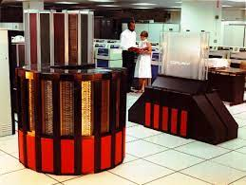
Changing the World cont’d.
As technology advances, the entry costs to their usage comes down.
This allows more and more people to use the available technology.
There were more than 6 billion+ mobile devices in use by the end of 2020.
Today, we all carry computer technology 1000x more powerful than NASA computers from the late 80’s!

Slide 6
Timeline –Digital Takeover
1988
Compact Discs become a viable storage solution for data.
1990 - 2004
Internet/Email
2007-2010
First Iphone released; first Ipad released.
2011 - 2015
4G mobile speeds introduced, Cable broadband surpasses 50% of all home Internet connections.
Today
5G mobile speeds are common, and fiber optic broadband proliferates for home Internet.

Slide 7
Marketing Follows Digital
Marketing departments from all types of industries have engaged in some type of print to digital transformation for marketing.
This transformation has been driven by how we consume media, and the rate in which we consume it.
Average American spends 11 hours per day online.
82% of Americans have a social media account.

Slide 8
Benefits of Digital Marketing
Digital marketing is low-cost compared to other marketing channels.
Digital marketing content can easily be updated.
Digital marketing interaction is trackable.
Follow up marketing touches can be tailored based on the gathered interaction data.
Easy to incorporate audio, video, and even other website.

Slide 9
Digital Ad Exposure
In the 1970s, a typical person was exposed to between 500 and 1,600 ads per day through print, tv, and radio.
In 2022, that exposure rate has increased to between 4,000 and 10,000 ads daily, primarily through digital advertising on websites, social media, and apps.
2021-2022 ad revenue across the four big social media sites is up 46%.
2023 predicted to be even higher.
Also in 2022, mobile ad spending outpaced desktop ad spending for the first time in history.

Slide 10
Does Digital Break Through?
A San Jose State University study concluded we do process digital information in a much different manner than print.
Screen-based reading behavior was characterized by more time spent on browsing, keyword spotting, non-linear reading, and reading more selectively.
Less time was spent on in-depth reading, and concentrated reading. Decreasing sustained attention was also noted.
This trains our brains to screen out most digital advertising that we see.

Slide 11
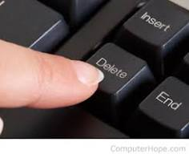
Other Hurdles
Not only have we trained our brains to not recognize most digital advertising, but there are also other hurdles that can keep your digital message from reaching its intended audience:
Spam filters – prevent your message from getting to Inbox.
Ad-blocking software and plugins – 40% of all Internet users are running some form of ad-blocking.

Slide 12
While the convenience and speed of digital communication cannot be dismissed, the sheer volume of digital content a person deals with daily can devalue the impact of digital marketing.

Slide 13
PRINT ENGAGES DIFFERERNTLY

Slide 14
Print Is Different
Research confirms that paper elicits more emotions than digital mediums conveying the same information.
Joint study by Temple University consumer neuroscience researchers and USPS.
Study found significant differences in the way our brains process print ads vs digital ads.
The results showed that paper documents elicit a more substantial response in terms of desirability and valuation.

Slide 15
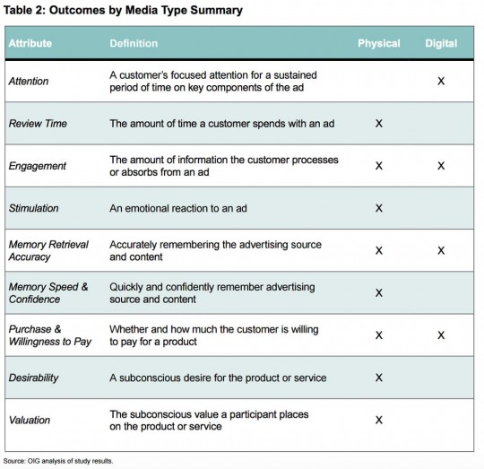

Slide 16
Print Is Different, cont’d.
Digital ads were processed more quickly, however print ads engaged viewer for more time.
Subjects absorbed roughly the same amount of information from both media types.
Testing subjects a week after exposure to both ad types showed greater brand recall, and emotional response from the print media ads.
Most significant finding of this study was that paper-based marketing activates the ventral striatum area of the brain more than digital media.

Slide 17
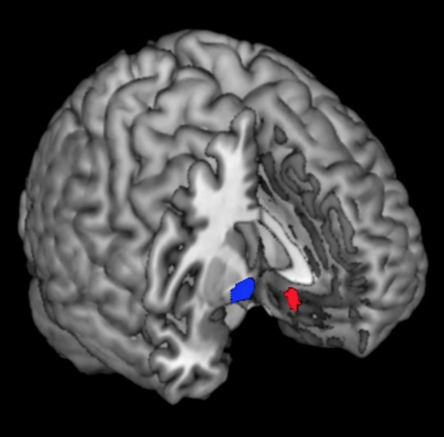
Print Is Valued
Using fMRI scans to produce 3D images of brain activity in specific areas, scientists noted print media showed greater activation of this area.
The ventral striatum has previously been identified as the area of the brain driving desire and valuation.
Researchers believe strongly that the reason for this result is rooted in the tactile response that paper provides.

Slide 18
Print Is Memorable
An additional study conducted by Bangor University, also used fMRI to study the effects of paper and digital media.
Test results showed physical material is more “real” to the brain, having meaning and a physical place to exist. It is better connected to memory because it engages with its spatial memory networks.
Physical material involves more emotional processing, which is integral for memory retainment, and recall.
Physical materials produced more brain responses connected with feelings, suggesting greater internalization.
Think about holding a printed concert ticket, or thank you note from a colleague. Their physicality gives them deeper meaning in our brains.

Slide 19
“We seem to forget that we gauge the world with all of our senses…”
- David Sax, author of
The Revenge of Analog:
Real Things and Why They Matter

Slide 20
Print Is Experiential
Paper Finishes – uncoated, glossy, linen, silk, plastic hybrid
Paper Weights/Thickness
Paper coatings – UV, silk, glossy, spot finishing, soft-touch, scented
Embossing; debossing; Die-cutting
Foil Stamping
Unique bindery options (saddle-stitching; folded options such as gatefold, Z-fold, etc)
Variable Data Printing – customized to each recipient
QR Codes

Slide 21
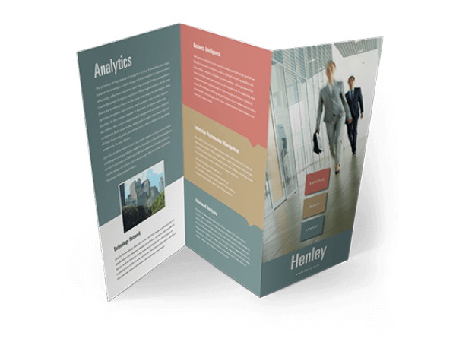
PRINT IS UNIQUE

Slide 22
Print Is Ideal for…
Face to face meetings.
Products or services that have a higher price tag.
Products or services that require a long-term financial commitment.
Products or services that involve a significant emotional investment.
Products or services that require the audience to refer back to marketing material numerous times before a buying decision is reached.

Slide 23
Great Marketing Starts With…
Knowing what your ideal client looks like.
Understanding key demographics, buying habits, of target audience.
Build your list – a good or bad list is the key to successful marketing.
Develop your message; define and refine your value proposition.
Clearly demonstrate what sets you apart from your competition.
Commit to a multi-touch approach for maximum ROI.

Slide 24
Key Takeaways
Science clearly shows paper can be more impactful and memorable than digital.
But marketers should take advantage of the unique properties both print and digital have to offer.
Digital marketing techniques are effective at presenting up-to-date content; building lists; presenting ideas quickly.
Print marketing is best used at presenting detailed information, and value propositions supported by data.

Slide 25
Thank you
John Kirchner
jkirchner@alphagraphics.com
630-453-7230

