Slide 1
Balancing resident Expectations, Operational Efficiencies, and anxiety of a new Dining program

Slide 2
Changing Expectations: Both the residents and the Expectations are changing

Slide 3
Changing Times - Major Factors
Baby Boomer expectations – for themselves and their parents
Still need to appeal to current Silent Generation residents
Multiple Venues and Branding
Flexible Meal Plans
Sustainability
Technology, including robotics
Mobility
Staffing Challenges
Continued demand for Take out and Delivery post Covid
Notes:
Schelley

Slide 4
Boomer Expectations
Boomers are the current marketing focus, yet still need to maintain features which appeal to current Silent Generation residents
Younger Boomers are helping parents in the decision-making process
Contemporary features are popular with Boomers, but not necessarily current residents
Multiple venues, especially Pubs and al Fresco dining
Flexible Meal Plans
Destination Dining and Special Events
Online ordering of take-out and delivery; reservations
Notes:
Schelley

Slide 6
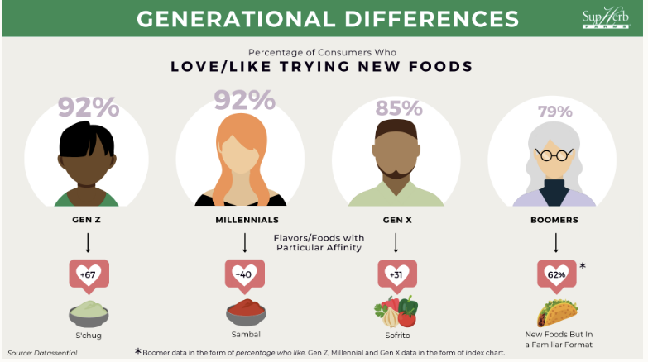

Slide 7
Restaurant Trends
Automation – both Back of House and Front of House, not intended to reduce staffing, but fill the staffing void.
Online and kiosk for delivery and pick-up
Menu transparency and sustainability

Slide 8
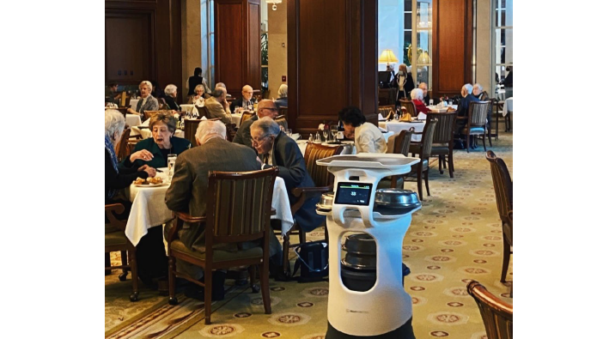

Slide 9
Multiple Venues
More Than Main Dining Rooms
Notes:
Think of your favorite restaurant. Now imaging having every meal there.

Slide 10
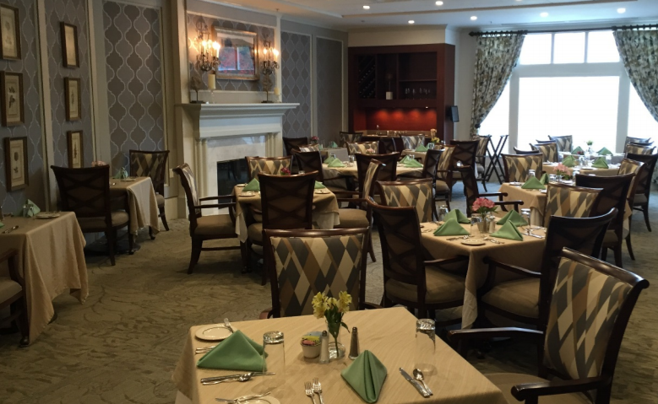
Full-Service Restaurant
Notes:
Schelley

Slide 11
MarketPlace/Food Hall
Notes:
Schelley

Slide 12
MarketPlace/Food Hall
Notes:
Schelley

Slide 13
Pubs
Notes:
Schelley
Also referred to taverns, tap rooms, lounges. Should have a branded name. This is most frequent third venue
Food menus are recommended, but some are strictly drinks and pre-meal gathering places.

Slide 14
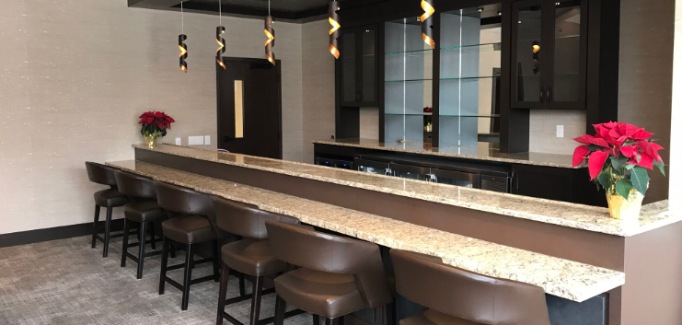
Notes:
Note height

Slide 15
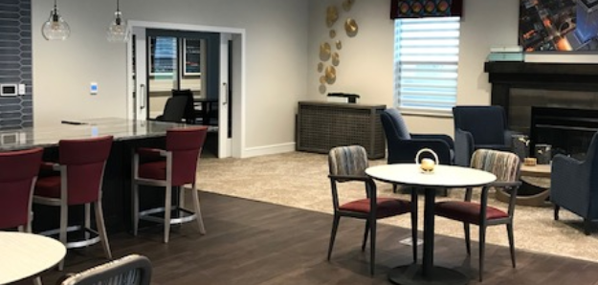

Slide 16
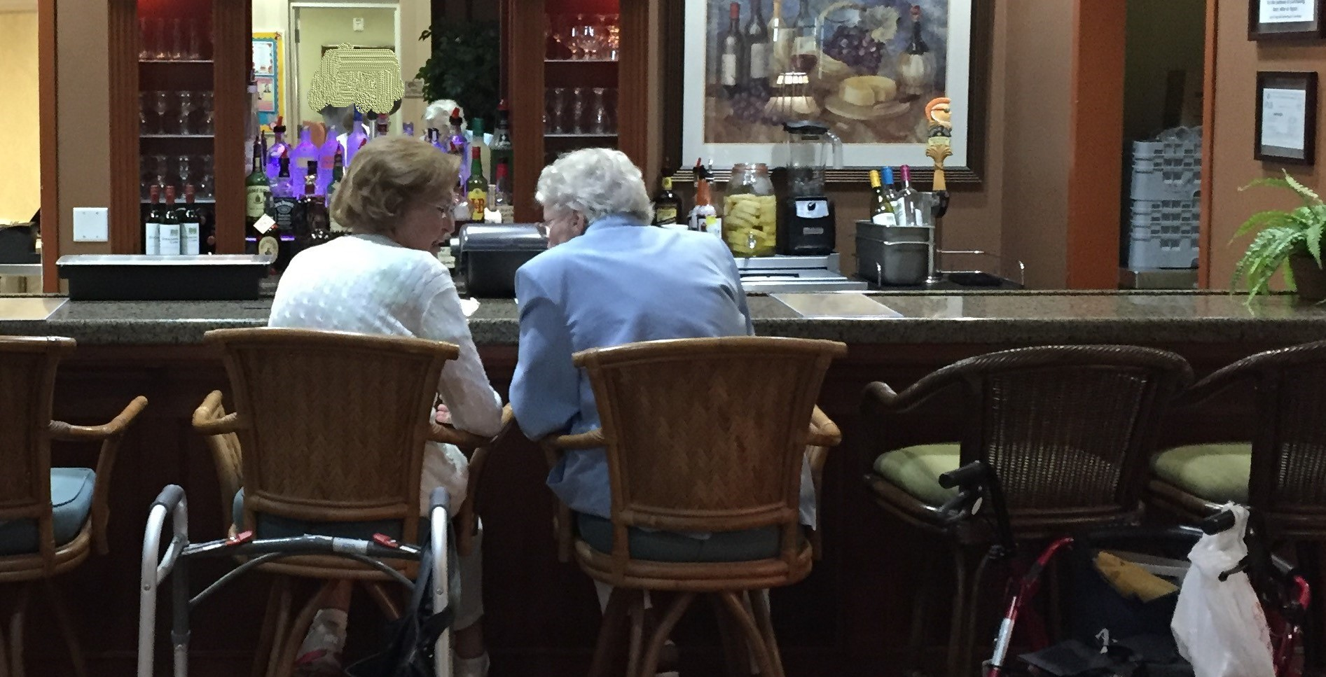
Notes:
If you build it they will come!

Slide 17
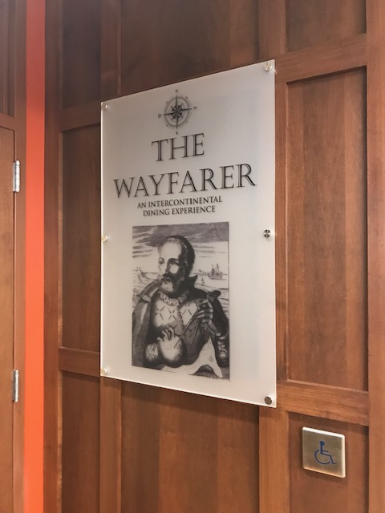
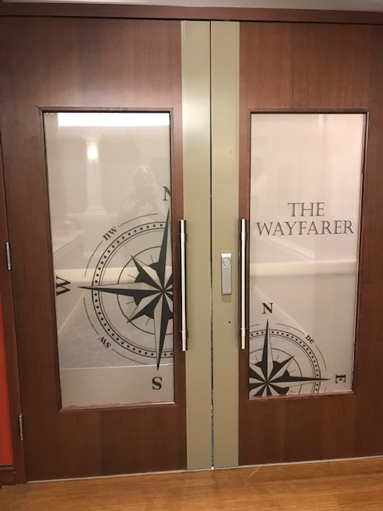
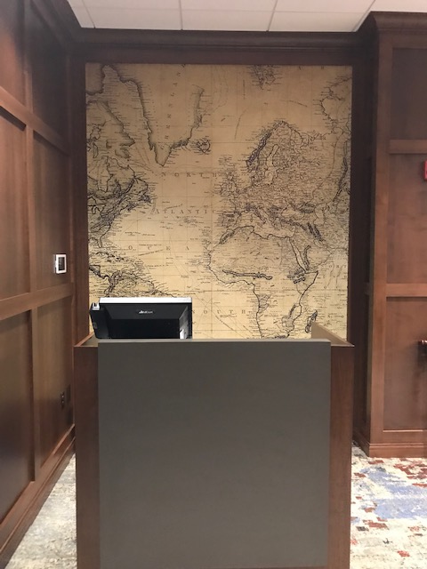
Destination Dining and Pop-ups
Notes:
Branding!!

Slide 18
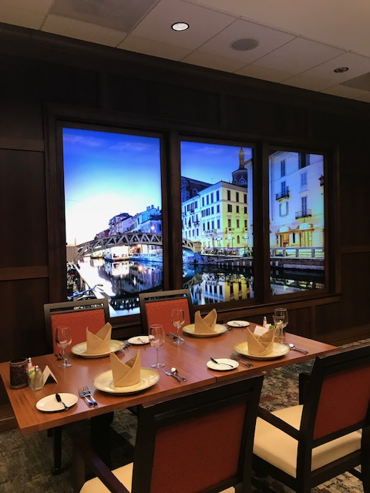
Notes:
Modest décor changes to complement theme

Slide 19
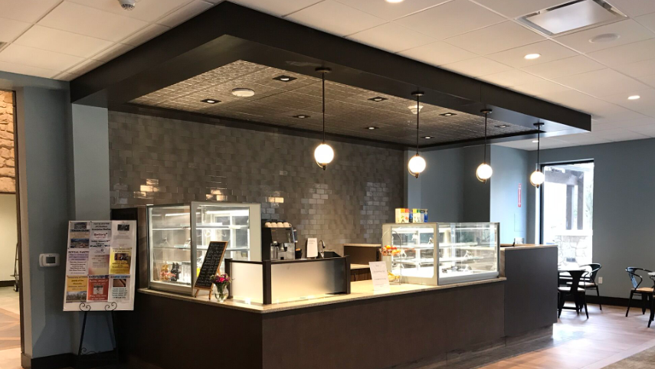
Small venue
Notes:
Aaron
Solution for small spaces. Starbucks style with upscale coffee, bakery, quick serve soup and sandwich

Slide 20
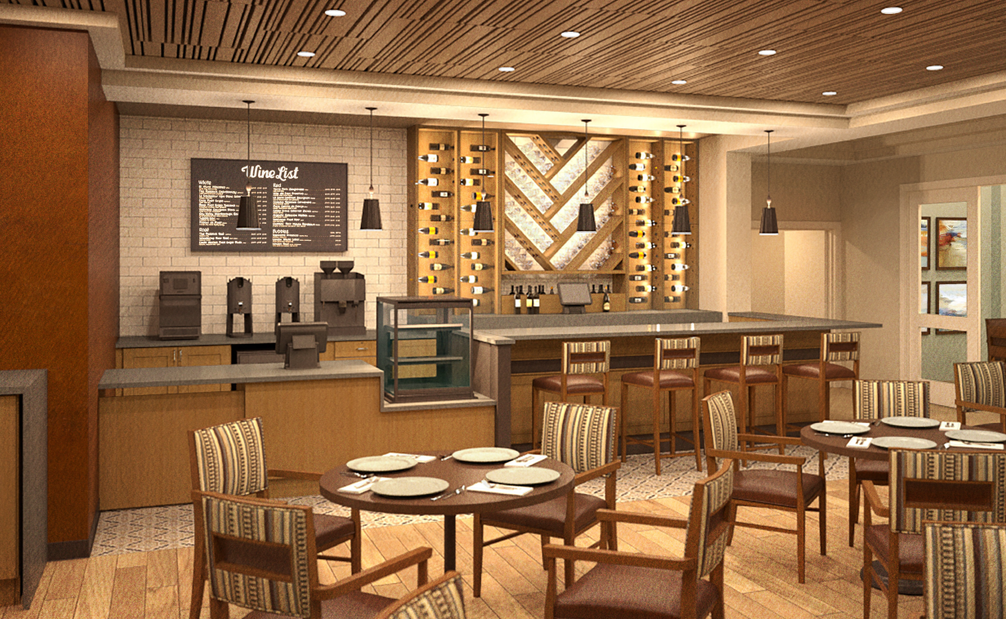
Flex Bar
Notes:
AAronBreakfast Bar in morning, adds wine, spirits and later menu for various day parts.

Slide 21
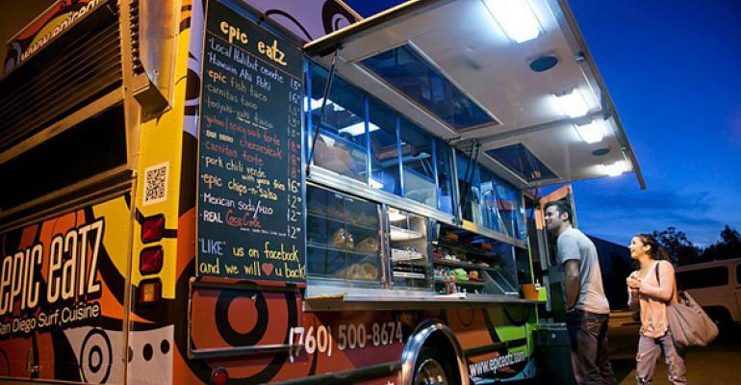
Food Trucks
Notes:
Schelley

Slide 22
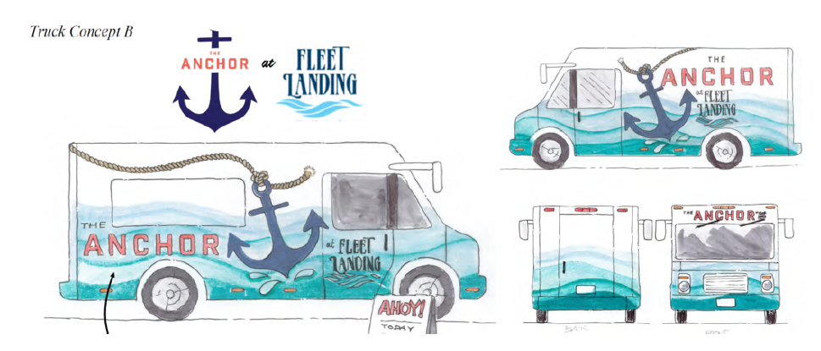
Concept Rendering for a Retirement Community

Slide 23
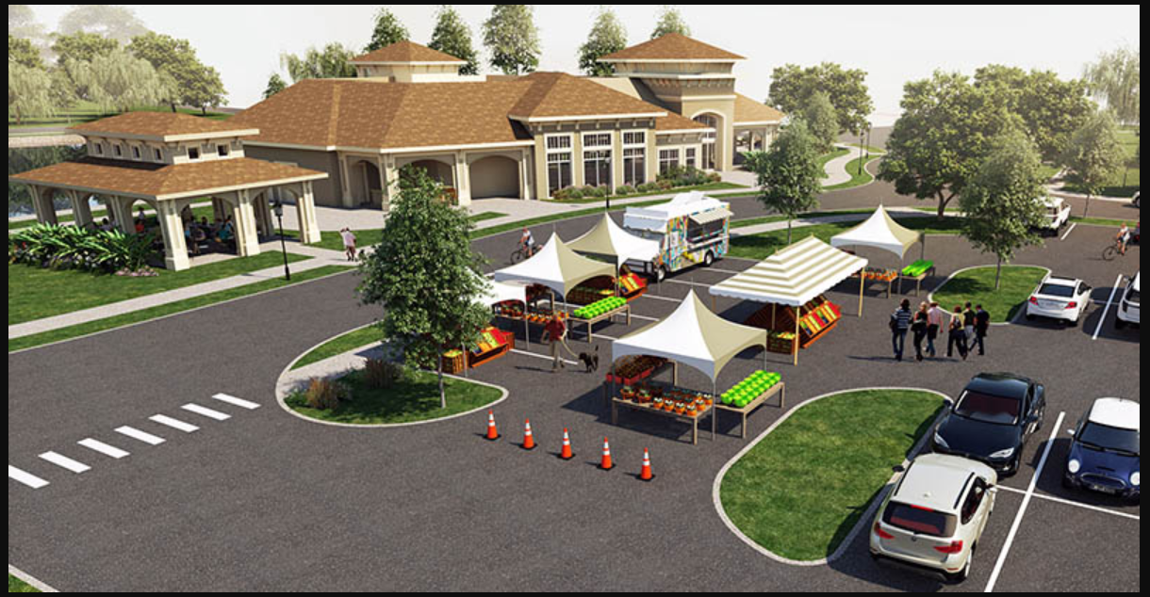

Slide 24
Venue Summary
Three Independent Living Venues is now the norm
Full-Service Restaurant
Fast Casual Option such as Marketplace or Bistro
Pub

Slide 25
Features
More Than Main Dining Rooms
Notes:
Think of your favorite restaurant. Now imaging having every meal there.

Slide 26
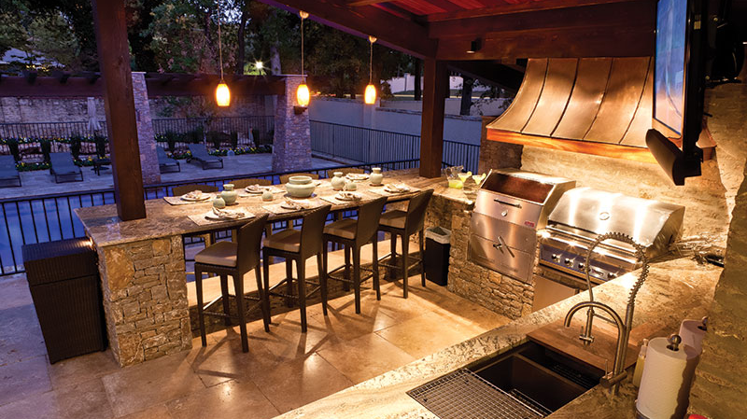
Outdoor Dining and Kitchens
Notes:
Aaron

Slide 27
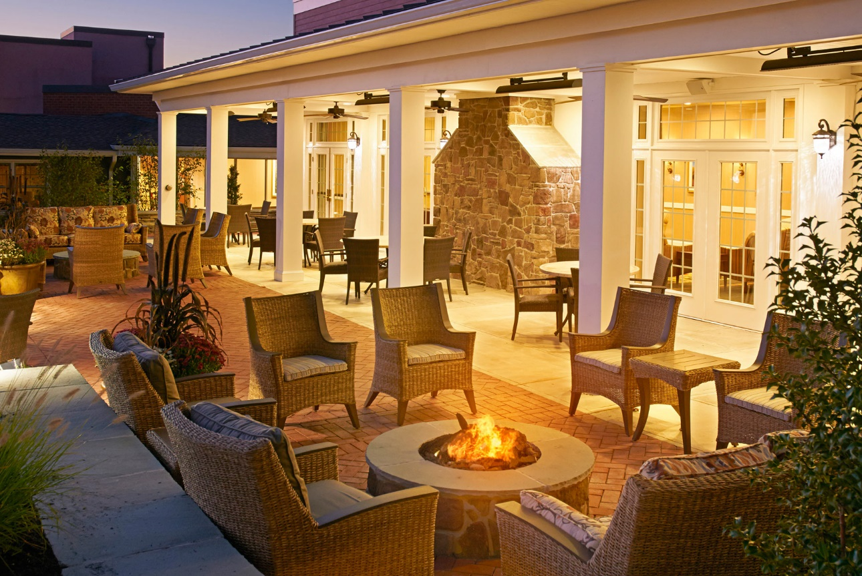
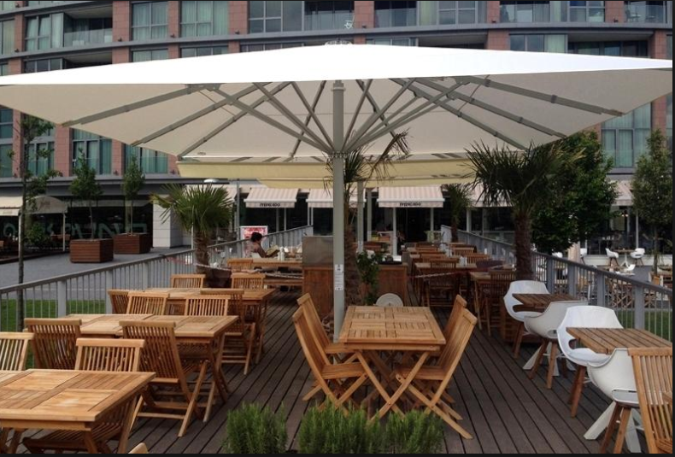
Protected Outdoor Dining
Notes:
Aaron

Slide 28
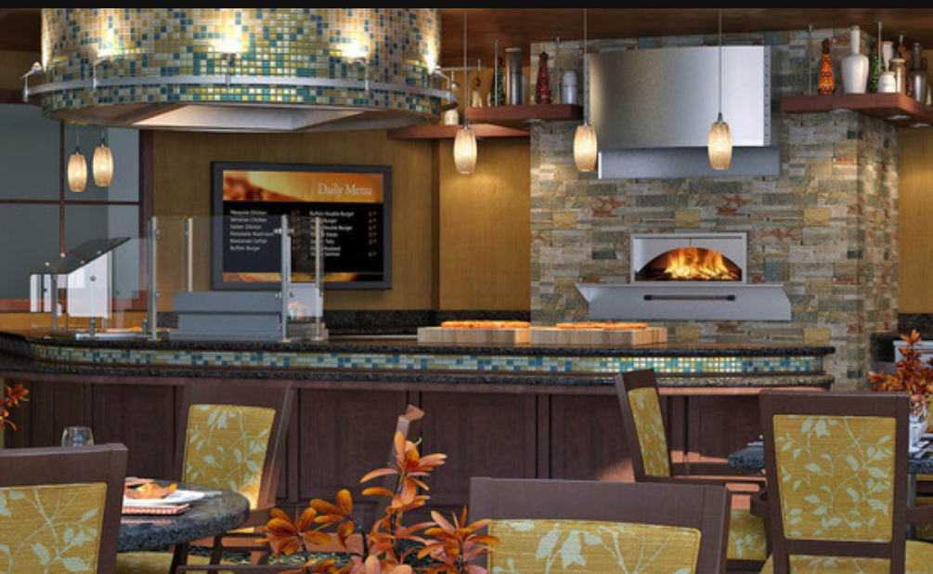
Chef’s Action Station
Notes:
Aaron

Slide 29
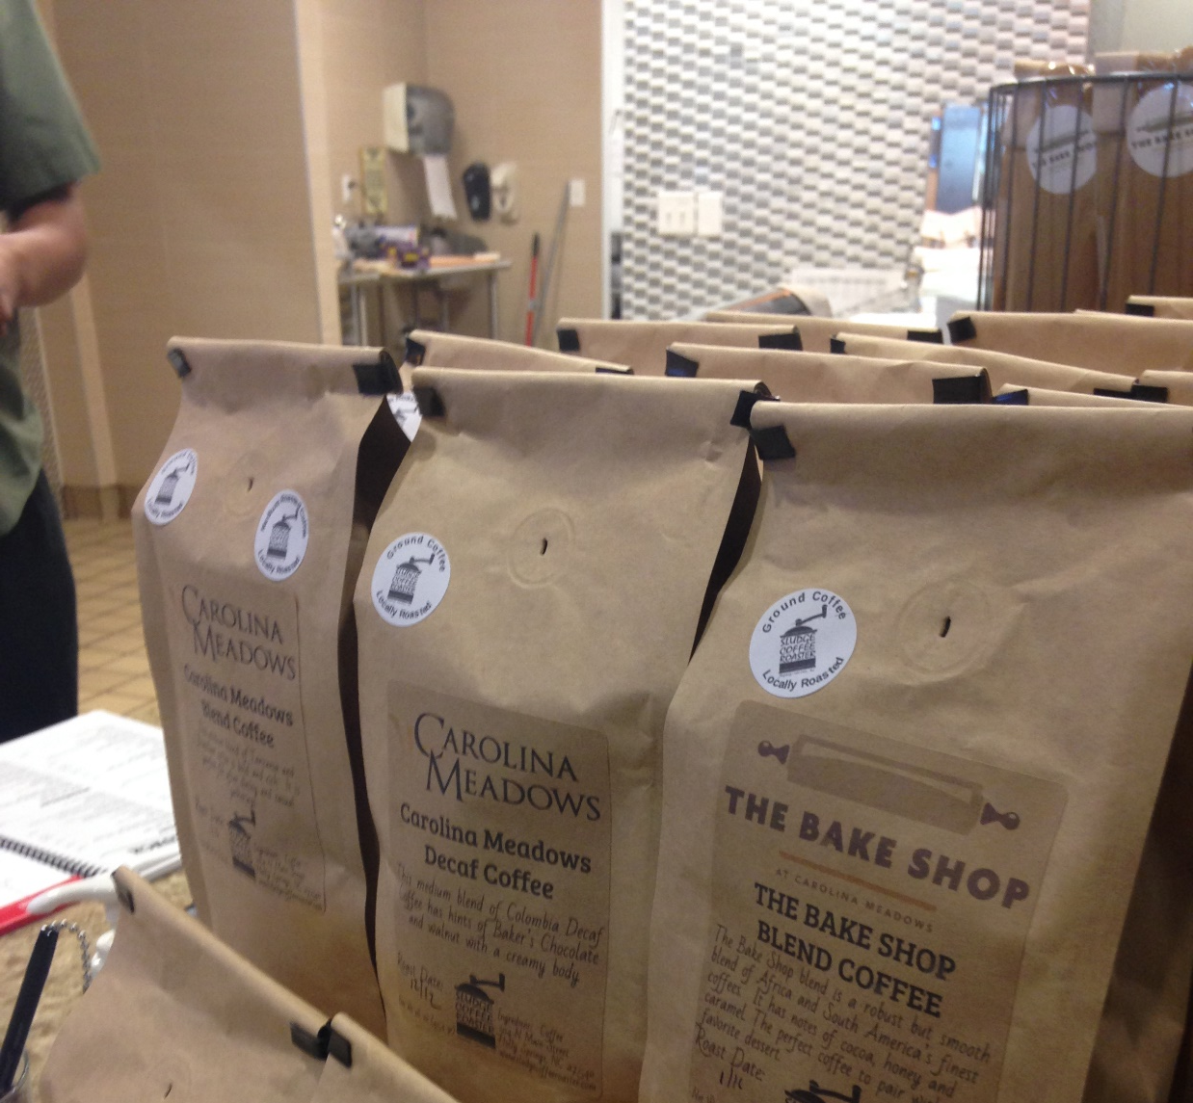
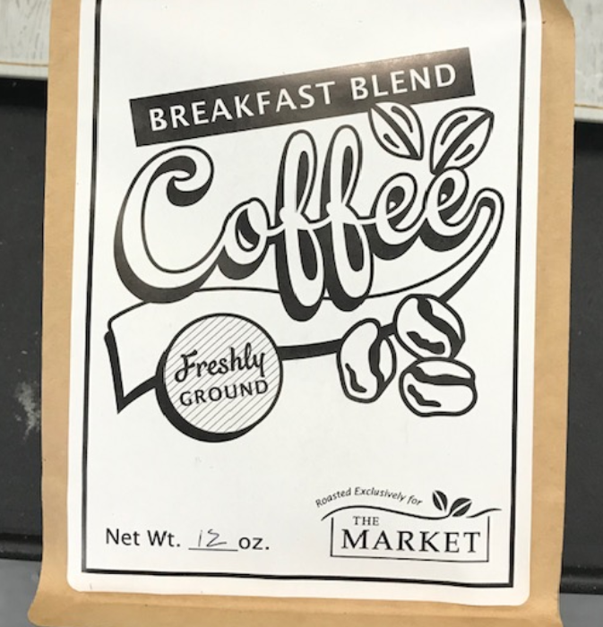
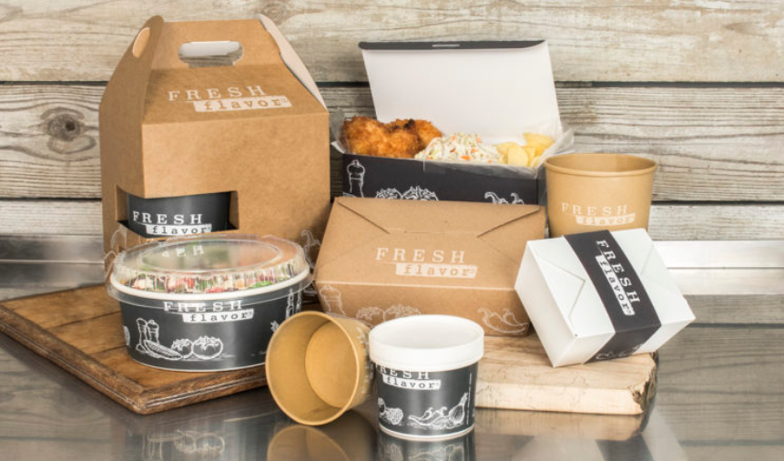
Branding
Notes:
Schelley
Note sustainability in packaging
Branding includes
Venue Names
Décor
Printed Menus and Signage
Packaging
Uniforms
Common Language – greeting

Slide 30
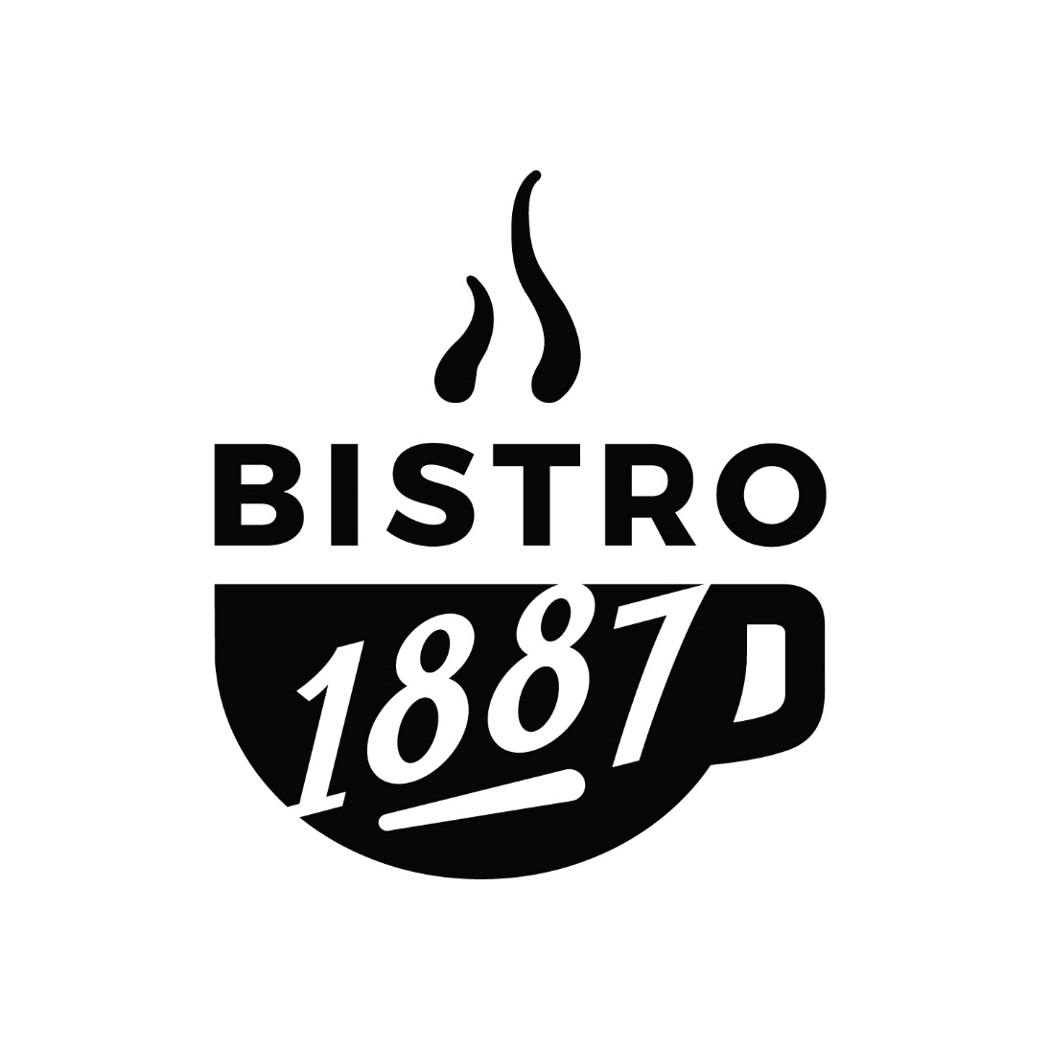
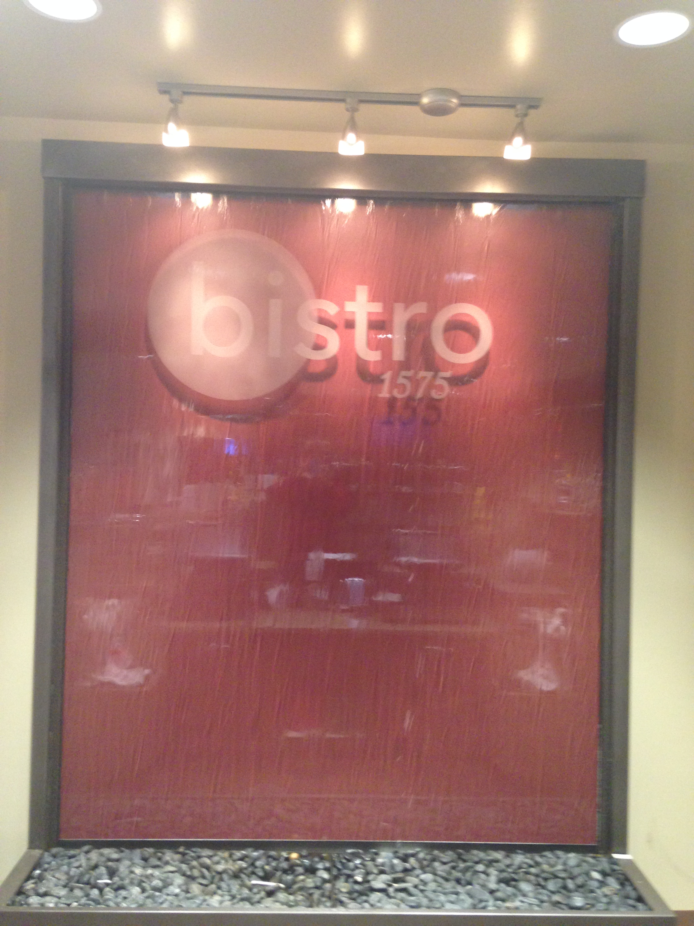
Branding

Slide 31
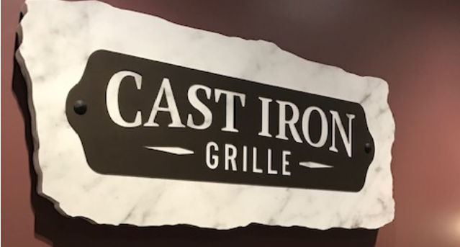
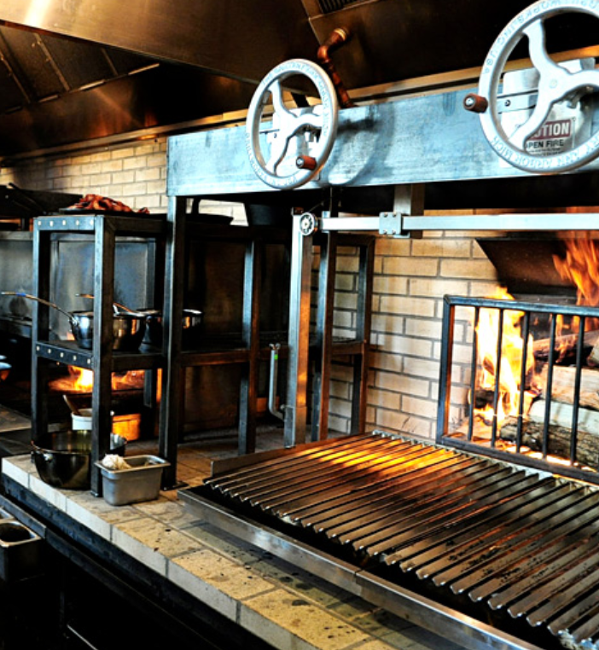
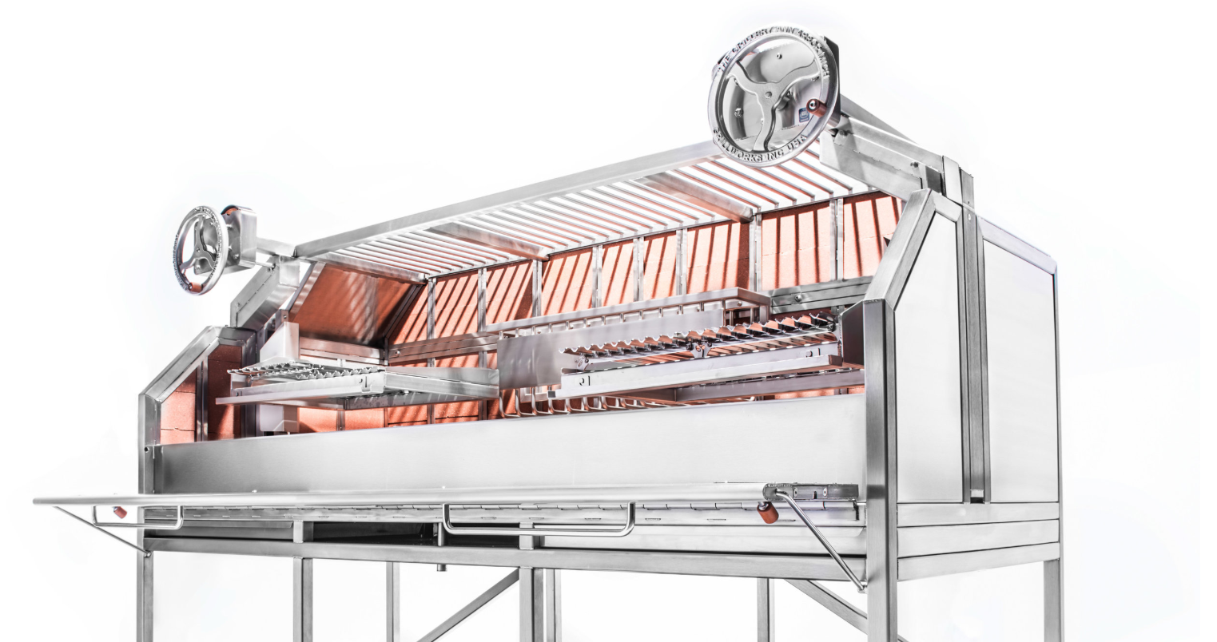

Slide 32
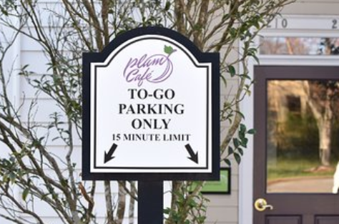
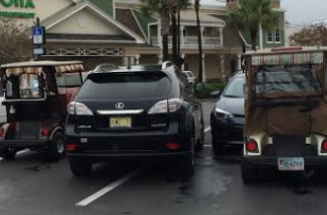
Take-out Parking
Notes:
Schelley

Slide 33
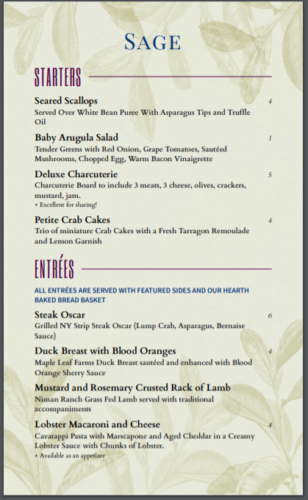
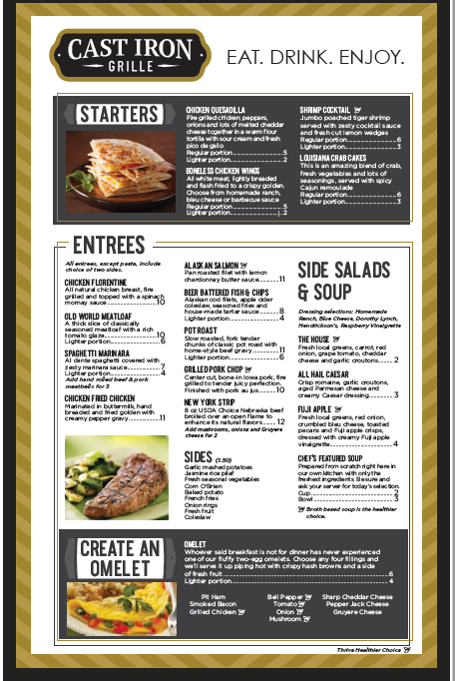
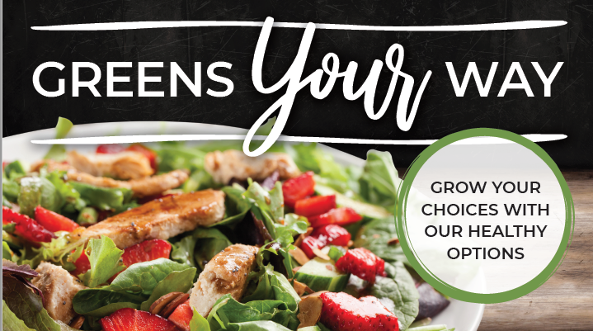
Presentation Menus

Slide 34
Branding Includes
Department Name : Hospitality Focus
Venue Names: no more “main dining room”
Décor
Printed Menus and Signage
Packaging
Uniforms
Common Language – greeting, Ritz Carlton
Signature processes, such as cocktail preparation
Notes:
Schelley

Slide 35
Menus, Meal Plans, and Technology

Slide 36
Menu Models
More Expansive “Always Available”, fewer daily cycle items (terrible term!)
Cycle items may run for a full week.
Residents can enjoy competing favorites if offered more than one day
MarketPlace stations with static menus
Cocktails and wine lists
Separate Dessert Menu
Unique Take-out
Off Menu Specials
Premium items
Notes:
Aaron
Speaking of Branding – can we get rid of Always available? Classic

Slide 37
Flexible Meal Plans
Flexible Plans - Points/Dollars, allow residents to take full advantage of multiple venues
Transitioning is a structured process to assure that plans are not over or undervalued
More than one plan is common
Country Club Style Plans
Key features
Guest meals
Alcoholic beverages
Roll over
Notes:
Schelley

Slide 38
Changing Budget and Pricing Methodology
No longer budget to a “food cost per meal” when using a flexible meal plan
Adopt a restaurant process and strive for approximately 33% Food cost
A menu item that include $1.00 Raw Food Cost, would be priced at $3.00
Strive for a net cost of dining operation that is break even or a modest subsidy, after applying Dining Dollars value

Slide 39
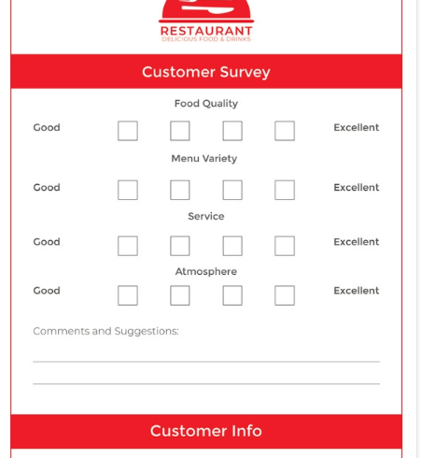
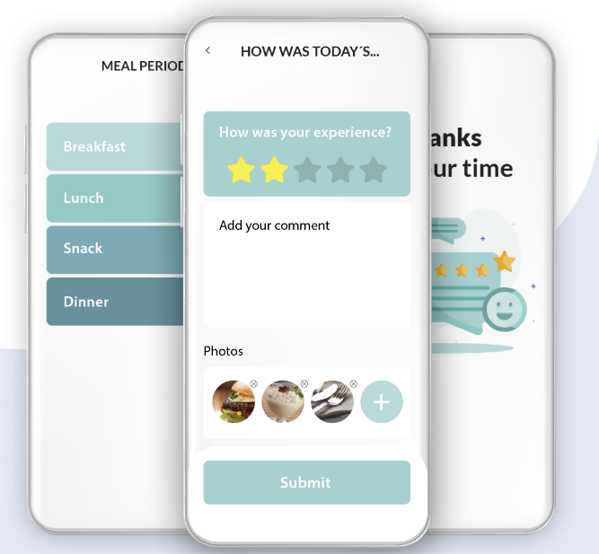
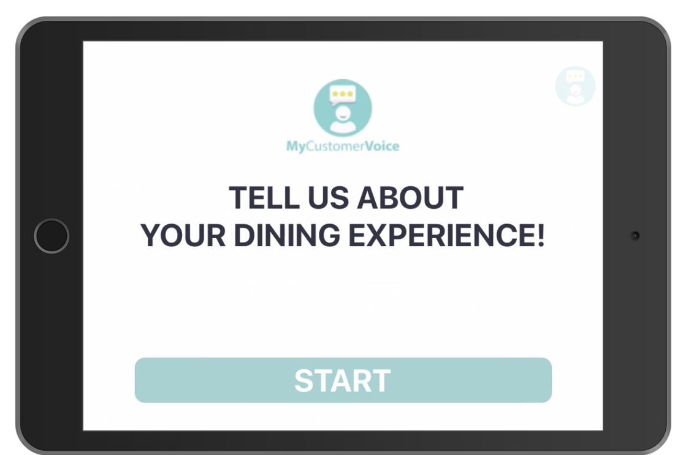
Customer Feedback Technology
Notes:
Schelley

Slide 40
QAPI

Slide 41
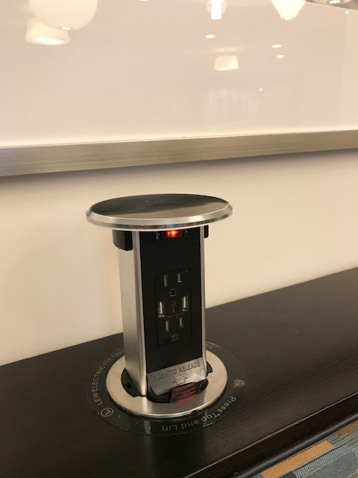
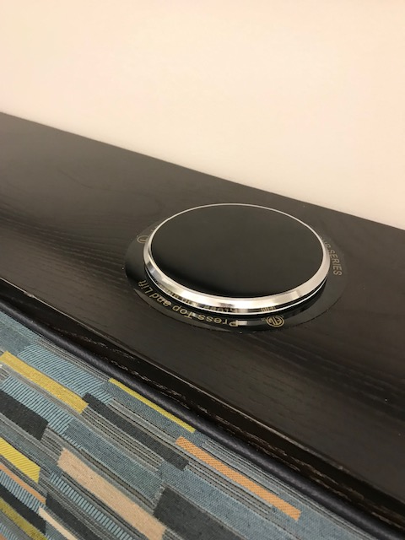
Pop-up Charging Station

Slide 43
Healthcare Dining
Assisted Living and Personal Care
Skilled Nursing
Memory Care
Short Term Rehab

Slide 44
Health Care dining
Access to IL Venues
Small Houses/neighborhoods
Short Term Rehab
Traditional Full-Service Dining
Secondary Venues
Notes:
Aaron

Slide 45
AL Bistro

Slide 46
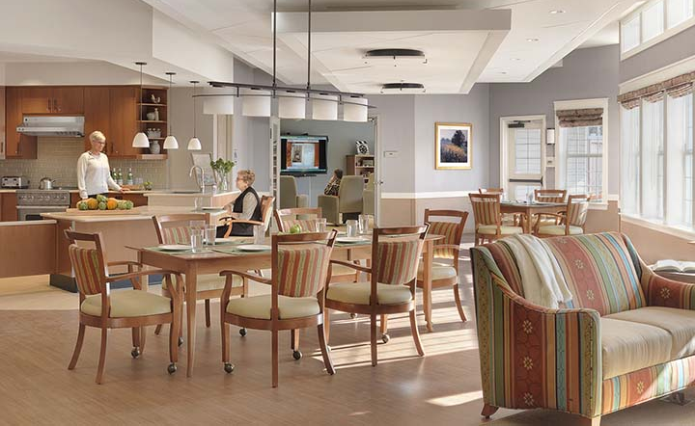
Small House

Slide 47
Rehab Dining

Slide 48
Rehab Dining
Photo courtesy of Perkins Eastman

Slide 49
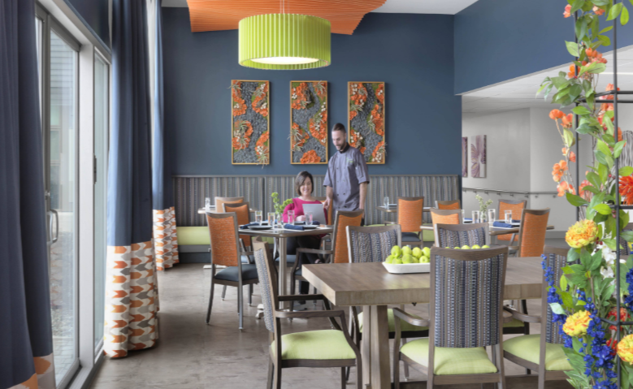
A True Restaurant Experience

Slide 50
More
Separate Kitchen for Take-out and Delivery
Real vegetable and herb gardens
Open to the public
Collaboration with restaurants, including use of meal plan
Charcuterie and cheese display
Gratuity Programs
Cashless

Slide 51
Right Sizing your Dining Venues
Increase in transactions by 20% upon transition to a flexible meal plan. A 30 meal per month plan results in 36 transactions
This flexibility increases meal participation during other day parts. Typically:
Breakfast at 12%
Lunch at 33%
Dinner at 55%

Slide 52
Right Sizing Your Venues
Based on the three typical venues (Full Service, Fast Casual, Pub)
Venue Utilization by Transaction based on 240/day |  | 240
Fast Casual (includes takeout) | 43% | 103.2
Pub - menu service | 13% | 31.2
Full Service | 44% | 105.6
 | 100%

Slide 53
How Many Seats?
Collect data from your POS system to determine the current traffic
Conduct resident focus groups to determine preferred dining times and preferred venue(s)
Typically:
Full-service restaurant will need about 80 seats for every 100 meals served at peak meal period (usually dinner)
Fast Casual venue needs about 50 seats for every 100 meals served at peak mealtime. Reduce for take-out meals
Pubs are unique to every community culture and the menu served. Usually range from 36 seats to 90 for communities with 250 residents

Slide 54
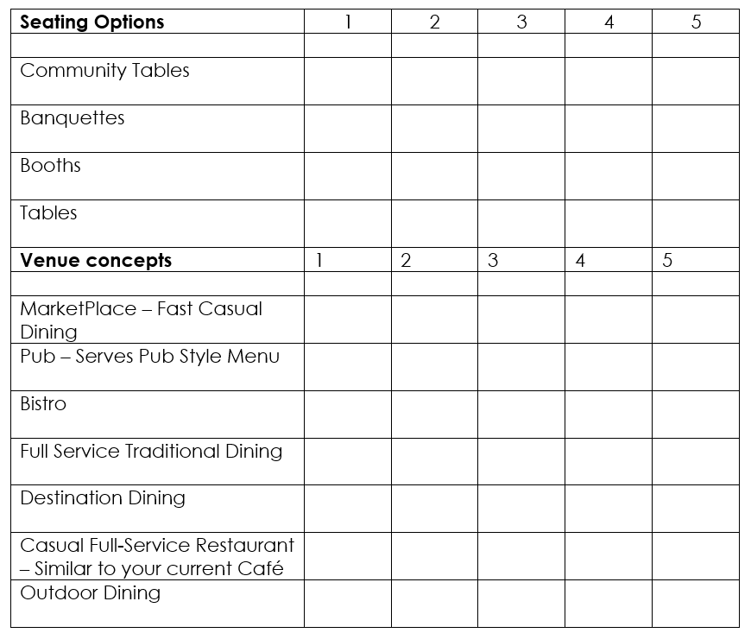

Slide 55
Questions?

Slide 56
www.thehollydaygroup.com

