Slide 1

Strategies for Successful Operationalizing Infection Prevention and Control in Assisted Living
October 3, 2023, Leading Age Naperville, IL

Slide 2
Learning Objectives
Describe the necessary components of an Assisted Living Infection Prevention and Control Program
Identify community infection prevention threats as well as public health resources for Assisted Living
Design and interdisciplinary Infection Prevention and Control program to improved resident safety

Slide 3


What is long term care?
“Long term care facilities provide a variety of services, both medical and personal care, to people who are unable to live independently. It is estimated that 1 to 3 million serious infections occur every year in:
nursing homes
skilled nursing facilities
assisted living facilities”
Source: CDC. https://www.cdc.gov/longtermcare/index.html
Notes:
CDC defines

Slide 4
Long Term-Care
Assisted Living^{t}
Hospice^{t}
Memory Support^{t}
Skilled Nursing*
Ventilator and Dialysis*
^{Pediatric LTC*}
Post Acute Care*
Long Term Residential*
Developmental Disabilities*
Continuum of Long Term-Care
t State Licensure
*State Licensure and Federal Certification

Slide 5
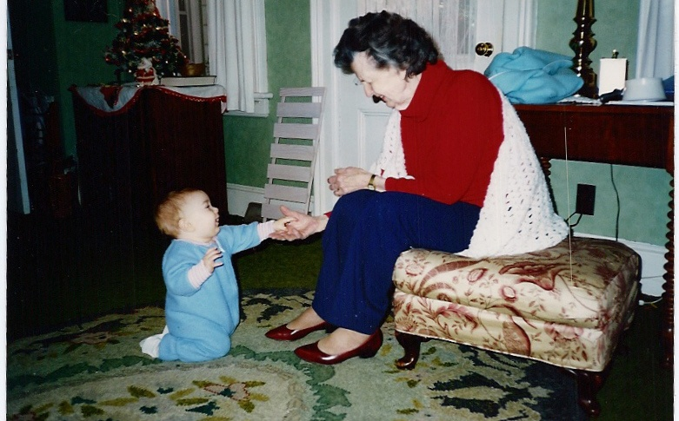
Provide a safe, competent, person-centered environment
© Mommarazzi Images (2007)

Slide 6
Balancing Risk and Person-Centered Care
Risk
Person Centered Care

Slide 7
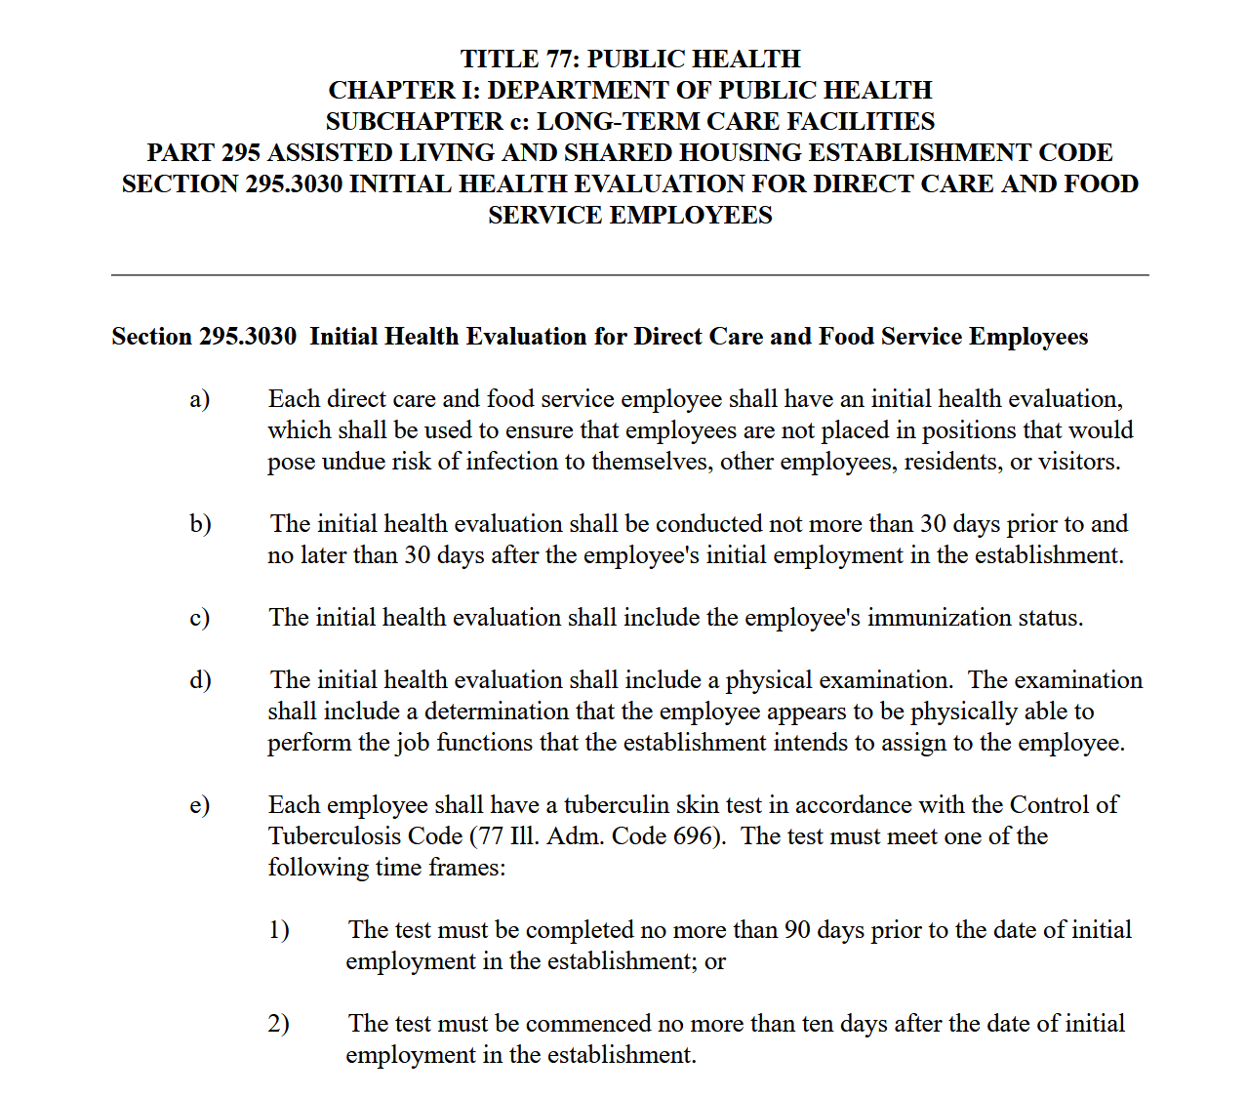
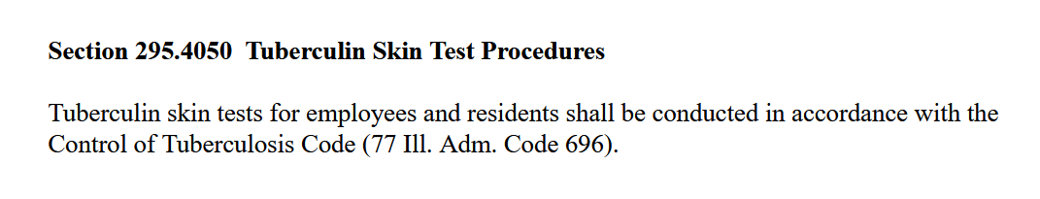
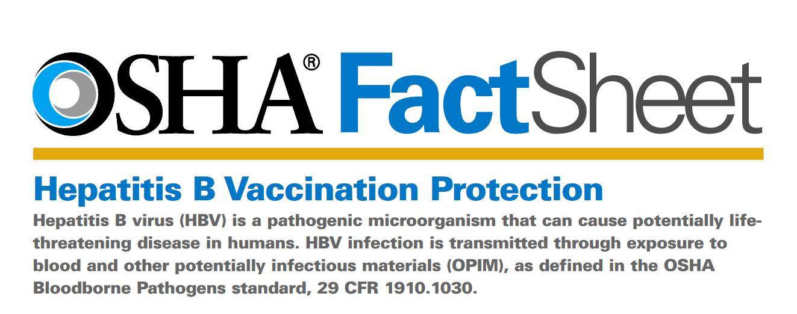
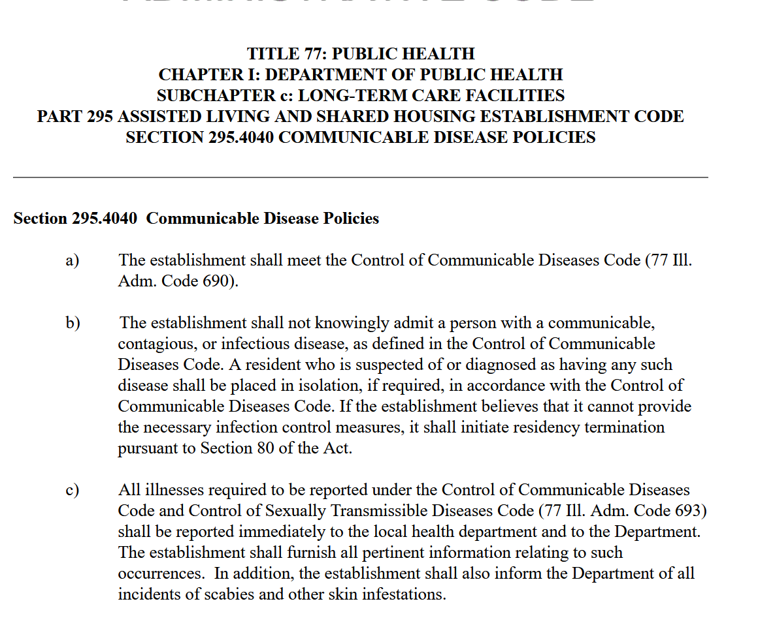
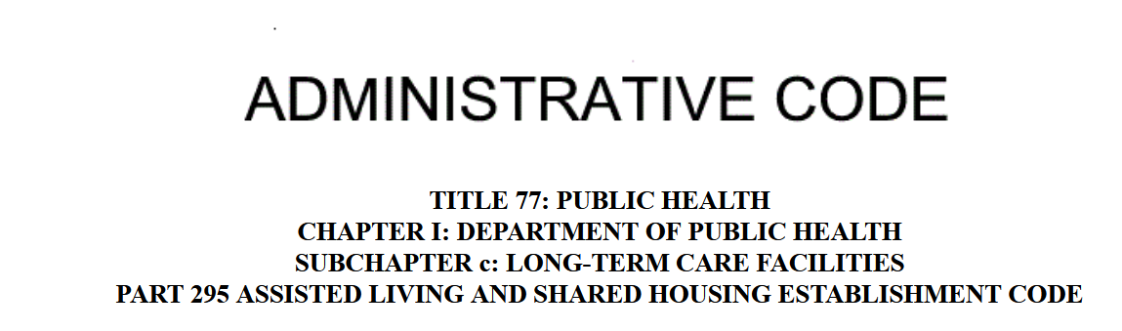
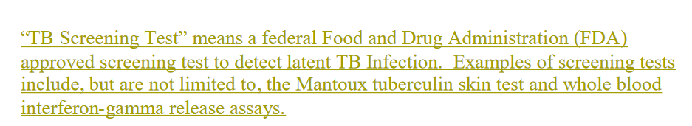
Knowing Rules Related to Infection Prevention and Control
Health Evaluations
Communicable Disease Code
TB Screening
Offering Hepatitis B vaccine
Respiratory Fit Test Programs
Personal Protective Equipment
https://www.ilga.gov/commission/jcar/admincode/077/07700295sections.html
http://www.idph.state.il.us/rulesregs/2007%20Rules/77%20ILCA%20696%203_15.pdf
https://www.osha.gov/sites/default/files/publications/bbfact05.pdf

Slide 8
https://www.ilga.gov/commission/jcar/admincode/077/07700295sections.html

Slide 9
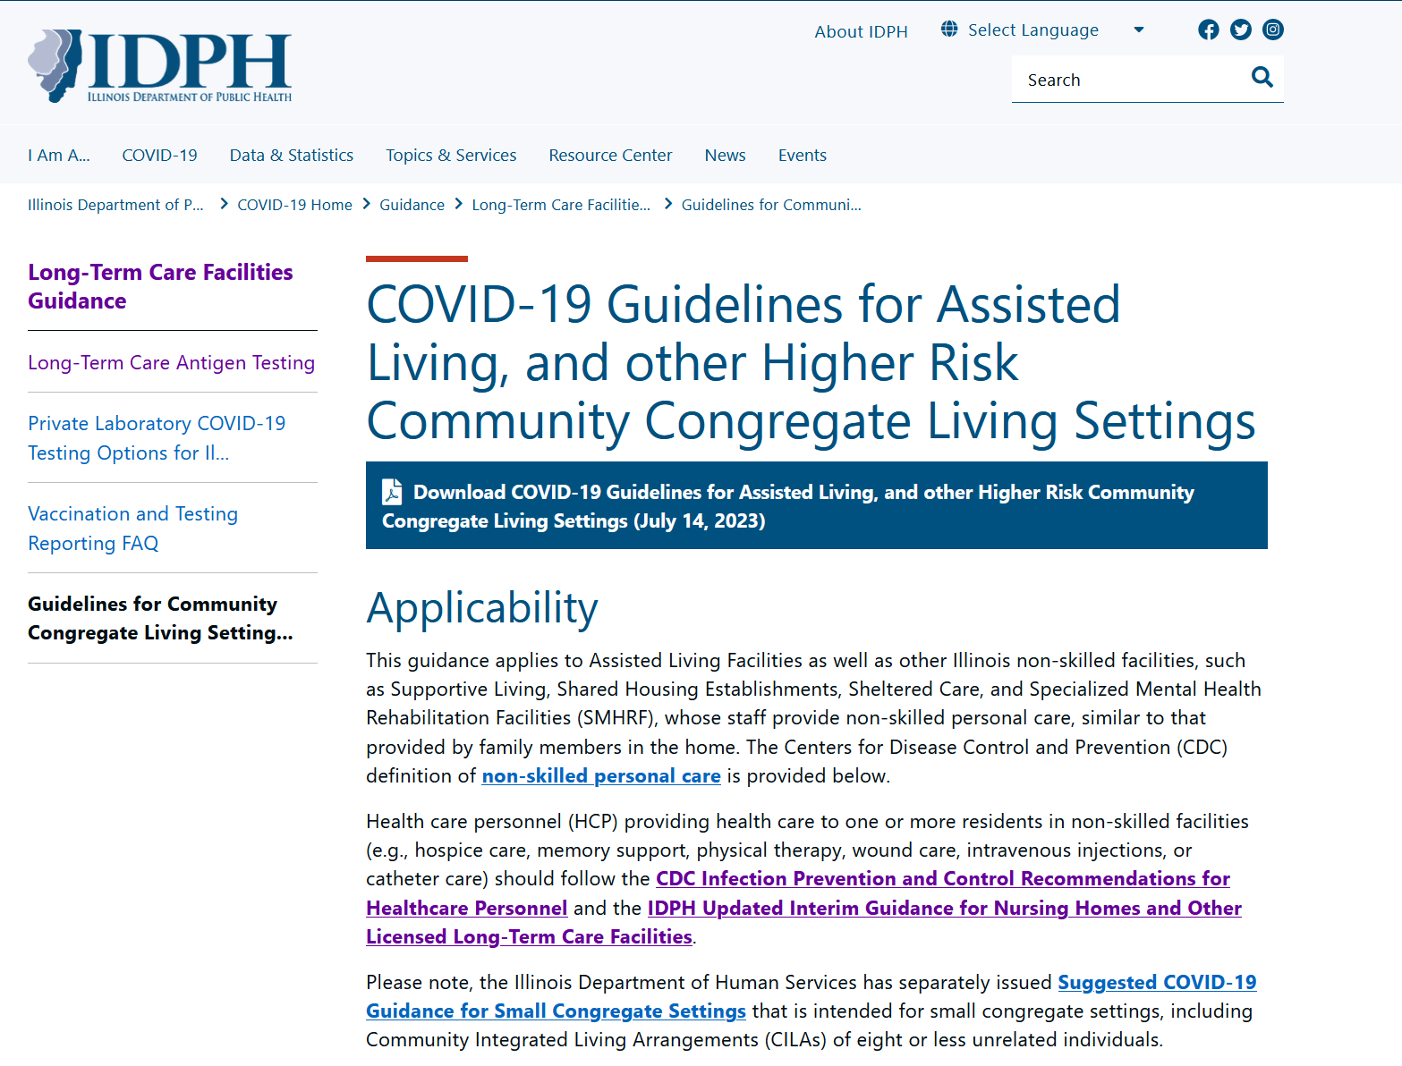
https://dph.illinois.gov/covid19/community-guidance/long-term-care/guidelines-community-congregate-living-settings.html

Slide 10
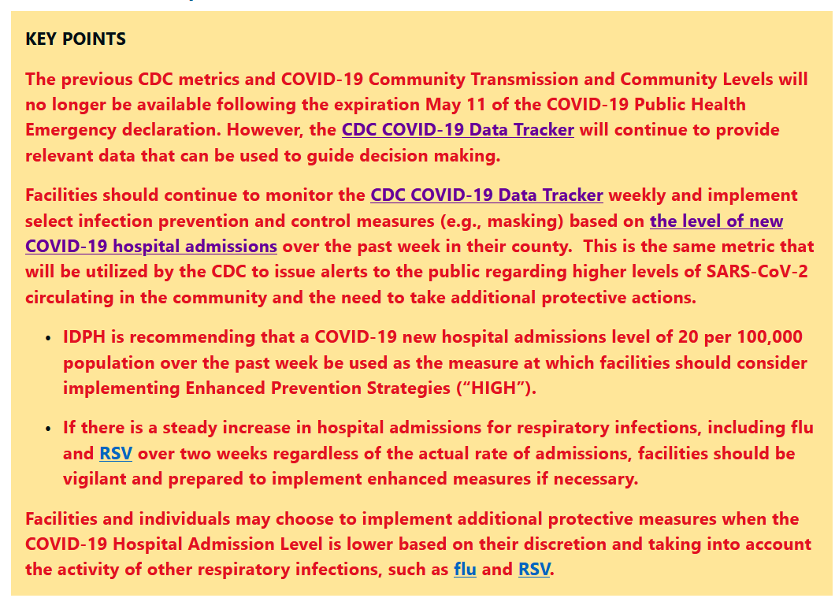
https://dph.illinois.gov/covid19/community-guidance/long-term-care/guidelines-community-congregate-living-settings.html

Slide 11

What are the Core Principles of Infection Prevention and Control?

Slide 12
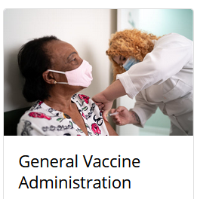

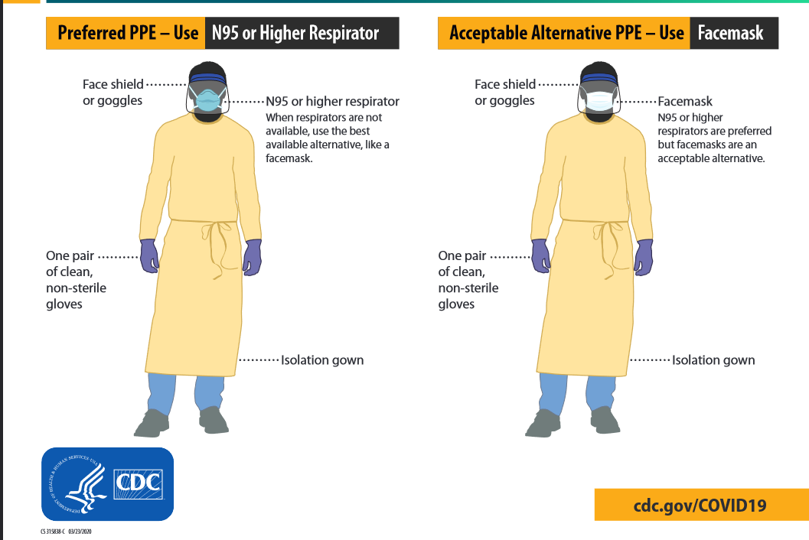
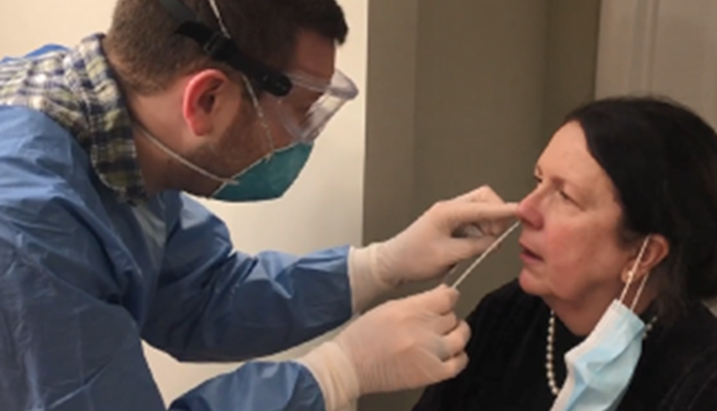
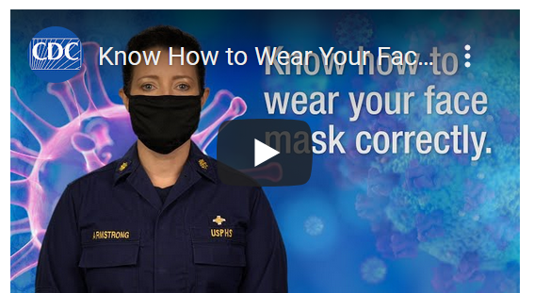
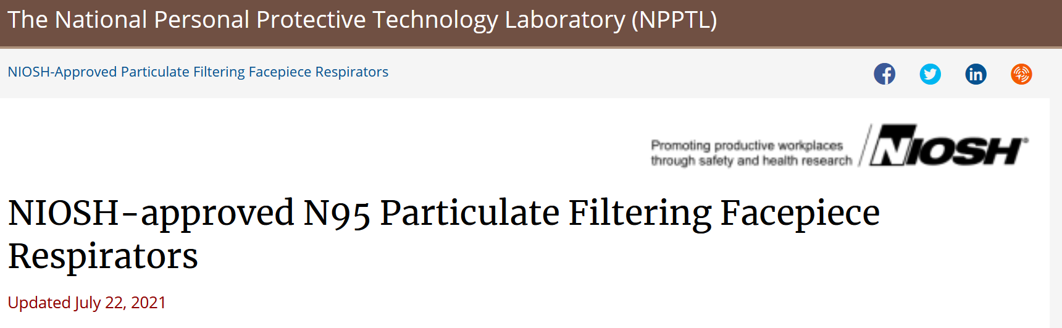


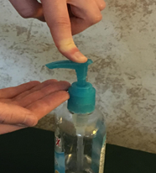
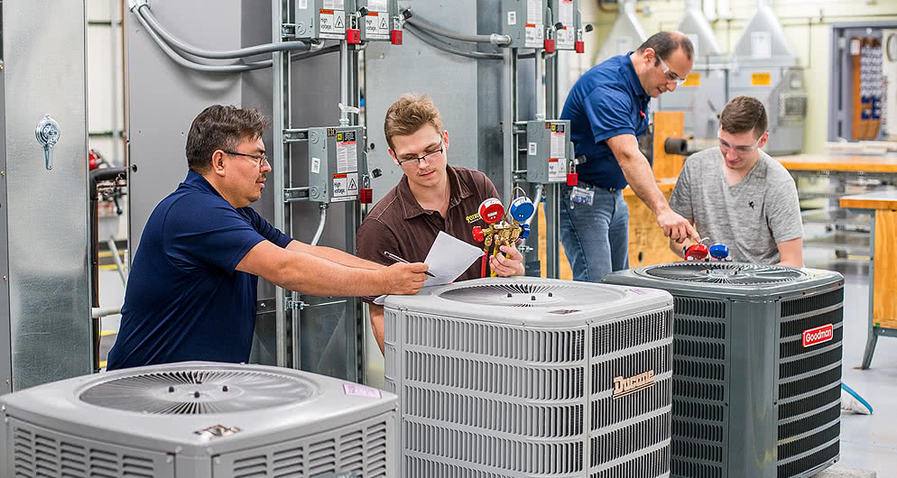

Detection, Isolation
Source Control / PPE
Screening and Surveillance
Surface Cleaning / Disinfecting
Image: Harper College
Ventilation/Air Filtration/Water Management
Hand Hygiene
Core Infection Prevention Practices
Notes:
Vaccination
Screening of all who enter the rehearsal space
Testing of unvaccinated and symptomatic persons
Hand hygiene (use of alcohol-based hand rub is preferred)
Face covering or mask (covering mouth and nose)
Physical distancing at least six feet between persons for unvaccinated persons
Instructional signage
Cleaning and disinfecting
Effective cohorting

Slide 13
Start with the Prevention Basics
Hand Hygiene and Standard Precautions
Proper use of Personal Protective Equipment (PPE)
Vaccinations
Cleanliness of Surfaces, Air, and Water
Prompt identification and isolation of ill individuals
Clear Communication and Documentation
Antimicrobial Stewardship

Slide 14

Infection vs. Colonization
What IS the difference?
Both potential protection from disease
AND
Reservoir of potential transmission

Slide 15

How do Infections spread?
Germ
A place for it to live
A susceptible host, specifically a person who does not have immunity to the germ
A way for the germ to enter the host such as:
  direct contact (touching contaminated surfaces, items)
  indirect contact (through contaminated food, water, feces, etc.)
  water droplets
  particles in the air

Slide 16
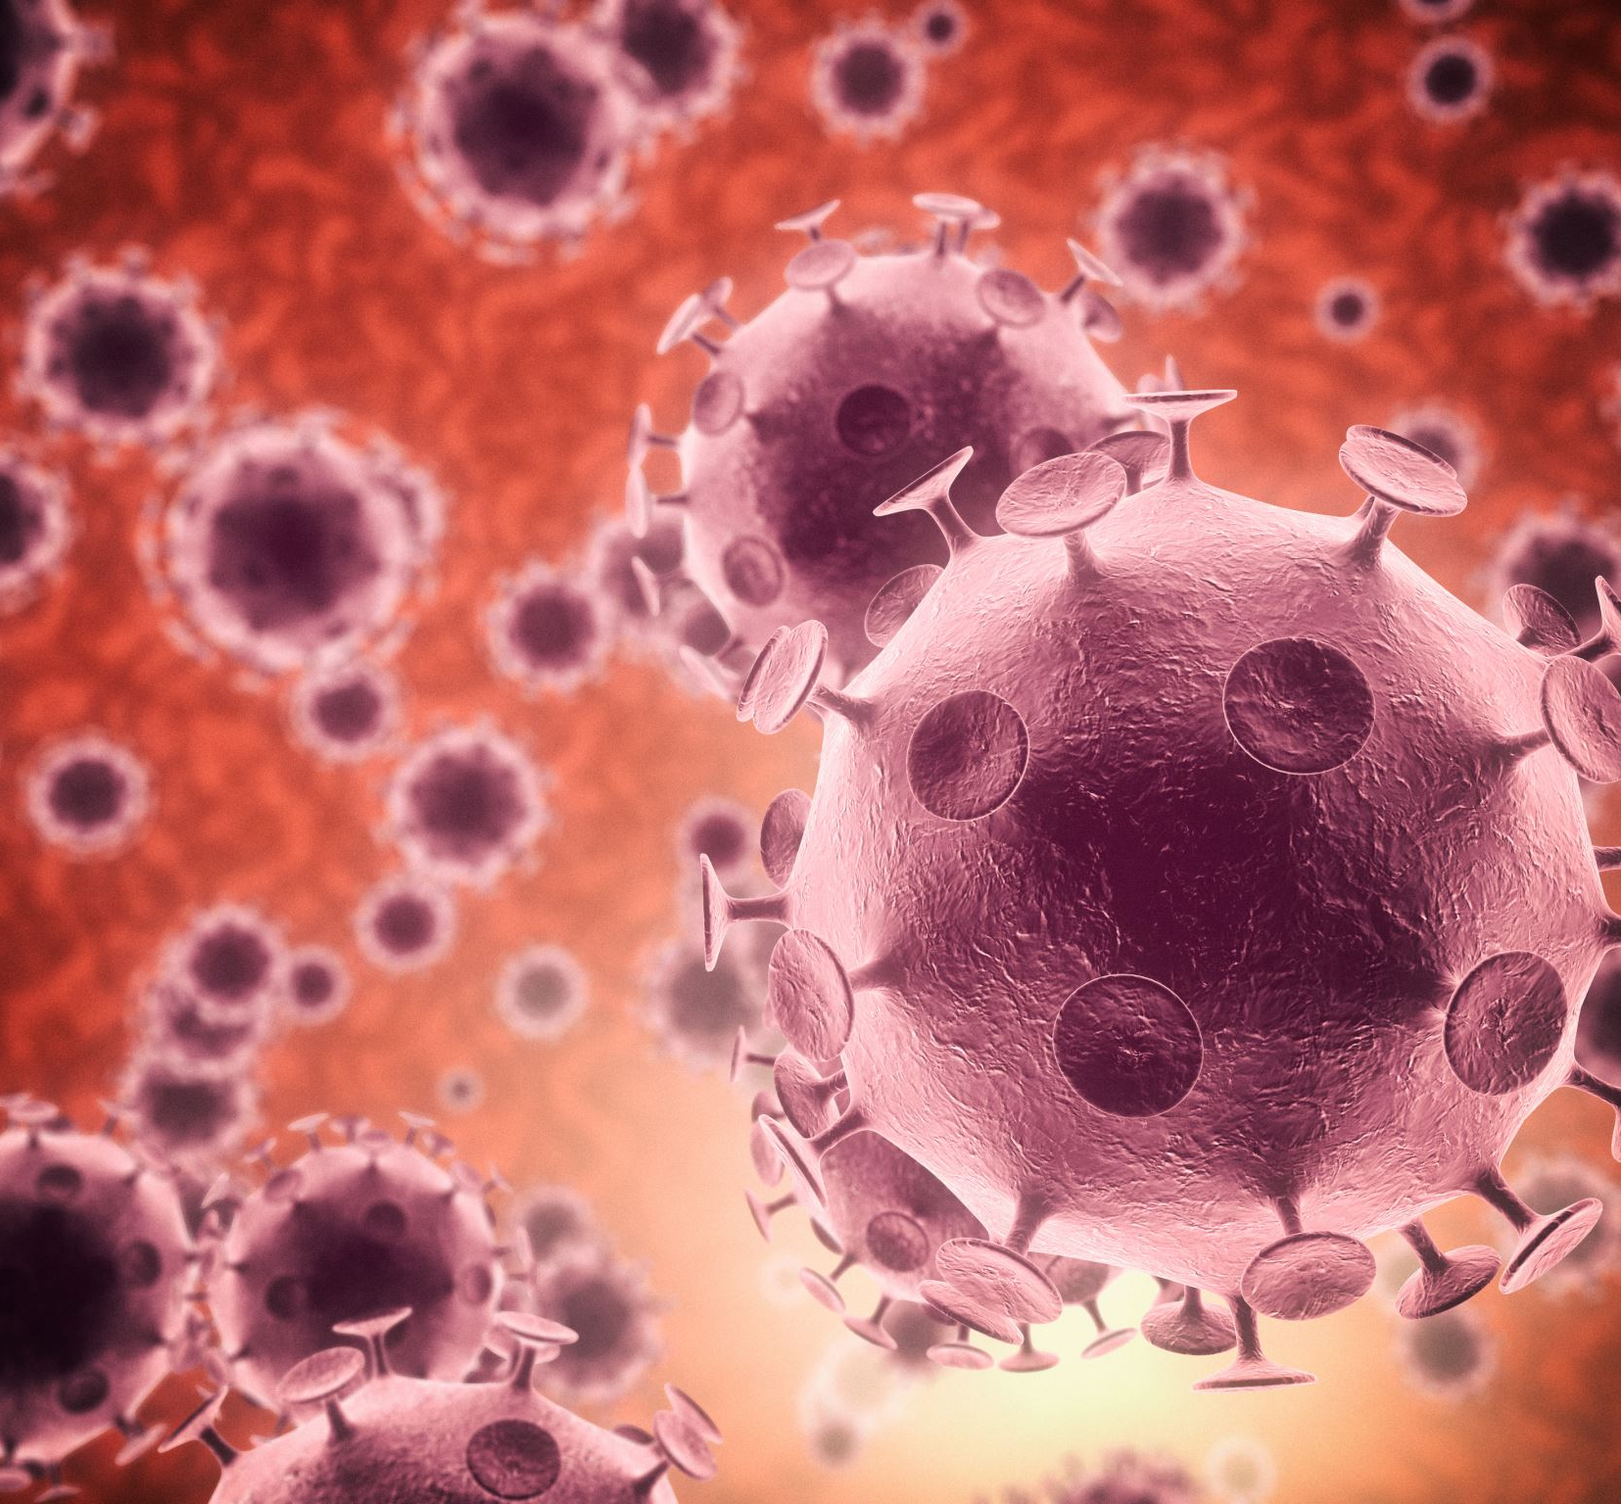
What would make an individual MORE Infectious?
Cold, cough or other upper respiratory symptoms
Febrile respiratory illness
Close contact with person or personal items
Uncovered wounds
Active diarrhea
Uncontained drainage

Slide 17
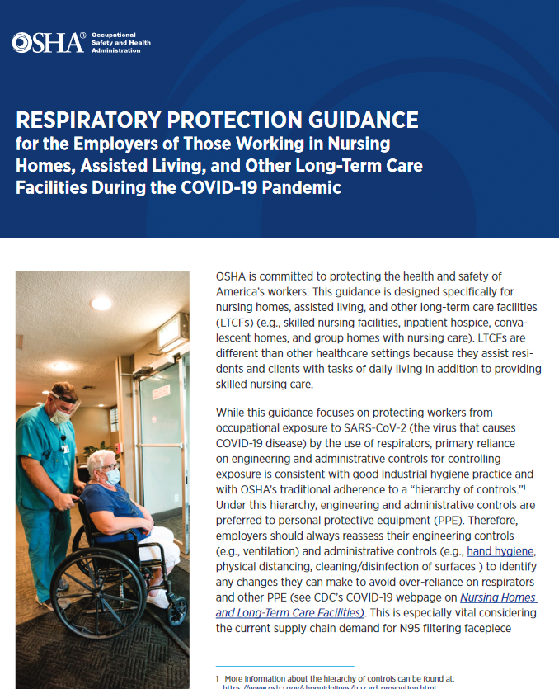
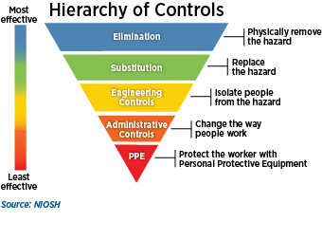
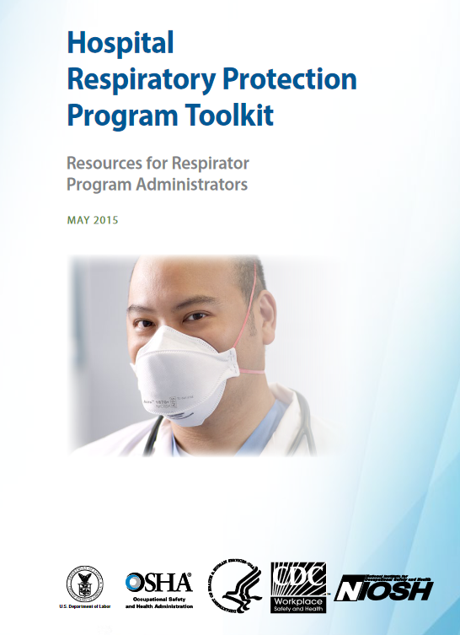
Respiratory Protection Program
What Needs More Focus in LTC
]
]
What We Have Done in LTC
Notes:
You may recall that we have discussed the Occupational Safety and Health Administration or OSHA Hierarchy of Controls before in relation to both engineering controls and PPE use. The approach that OSHA presents is that of an inverted pyramid where the most effective methods for controlling a hazard are at the top and the least effective are at the bottom. With all the focus on the use of personal protective equipment or PPE, it may seem surprising that PPE use is considered the least effective control.
While the respiratory protection program is the last line of defense, that should not minimize the importance of the program. The intent of the regulatory requirement is to create a safe environment.
While this guidance focuses on protecting workers from
occupational exposure to SARS-CoV-2 (the virus that causes
COVID-19 disease) by the use of respirators, primary reliance
on engineering and administrative controls for controlling
exposure is consistent with good industrial hygiene practice and
with OSHA’s traditional adherence to a “hierarchy of controls.”1
Under this hierarchy, engineering and administrative controls are
preferred to personal protective equipment (PPE). Therefore,
employers should always reassess their engineering controls
(e.g., ventilation) and administrative controls (e.g., hand hygiene,
physical distancing, cleaning/disinfection of surfaces ) to identify
any changes they can make to avoid over-reliance on respirators
and other PPE (see CDC’s COVID-19 webpage on Nursing Homes
and Long-Term Care Facilities). This is especially vital considering
the current supply chain demand for N95 filtering facepiece

Slide 18
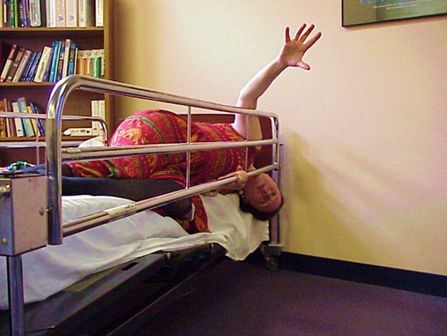
Paradigm Shift:
Remember Restraints?
1964 nursing textbook
“Guard against injury or accident by the use of side rails and careful observation”
Research showed side rails increased the risk of severe injury
1998 study by Elizabeth Capezuti, Neville Strumpf, Lois Evans, Jeane Ann Grisso & Greg Maislin
Regulatory change and the hard work of surveyors and facilities
Mommarazzi Images © 2008
Brunner, Emerson, Ferguson, & Suddarth, (1964, p. 342).
Capezuti, Strumpf, Evans, Grisso, & Maislin, (1998).
Notes:
One nursing textbook instructed nurses to observe the older patient for “dangers of mental changes and guard against injury or accident by the use of side rails and careful observation.” (Brunner, Emerson, Ferguson, & Suddarth. (1964, p. 342)
“Careful observation” was a critical component. Research showed side rails increased the risk of severe injury (Capezuti, Strumpf, Evans, Grisso, & Maislin, 1998)
Comprehensive Person-Centered Care Planning (§483.21) *New Section* We are requiring facilities to develop and implement a baseline care plan for each
resident, within 48 hours of their admission, which includes the instructions needed to provide effective and person-centered care that meets professional standards of quality care. We are adding a nurse aide and a member of the food and nutrition services staff to the required members of the interdisciplinary team that develops the comprehensive care plan. We are requiring that facilities develop and implement a discharge planning process that focuses on the resident’s discharge goals and prepares residents to be active partners in post-discharge care, in effective transitions, and in the reduction of factors leading to preventable re-admissions. We are also implementing the discharge planning requirements mandated by The Improving Medicare Post-Acute Care Transformation Act of 2014 (IMPACT Act) by revising, or adding where appropriate, discharge planning requirements for LTC facilities. Quality of care (§483.24) We are requiring that each resident receive and the facility provide the necessary care and services to attain or maintain the highest practicable physical, mental, and psychosocial well-being, consistent with the resident’s comprehensive assessment and plan of care.
Quality of Life (§483.25) Based on the comprehensive assessment of a resident, we are requiring facilities to ensure that residents receive treatment and care in accordance with professional standards of practice, the comprehensive person-centered care plan, and the residents’ choices.
Physician services (§483.30) We are allowing attending physicians to delegate dietary orders to qualified dietitians or
other clinically qualified nutrition professionals and therapy orders to therapists. Nursing services (§483.35) We are adding a competency requirement for determining the sufficiency of nursing staff, based on a facility assessment, which includes but is not limited to the number of residents, resident acuity, range of diagnoses, and the content of individual care plans (p.10)

Slide 19
Evidence and Expert Opinion
Evidence and Expert Opinion
CDC, WHO, APIC, SHEA, HICPAC
Guidance
Examples of Guidance, Standards, Rules, Regulations
Standards
Joint Commission, DNV, CARF
Rules and Regulations
CMS, State, OSHA, Local
Policies and Procedures
Facility Policies and Procedures

Slide 20
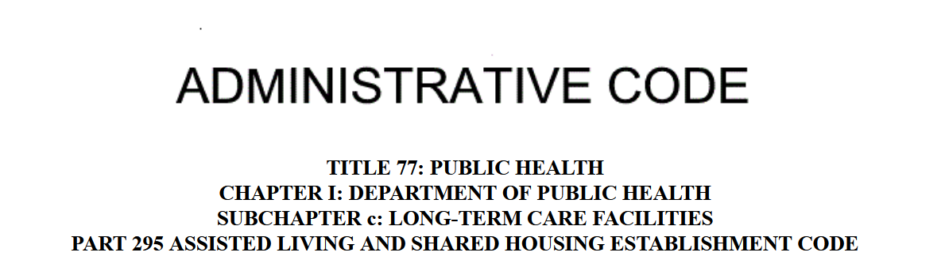
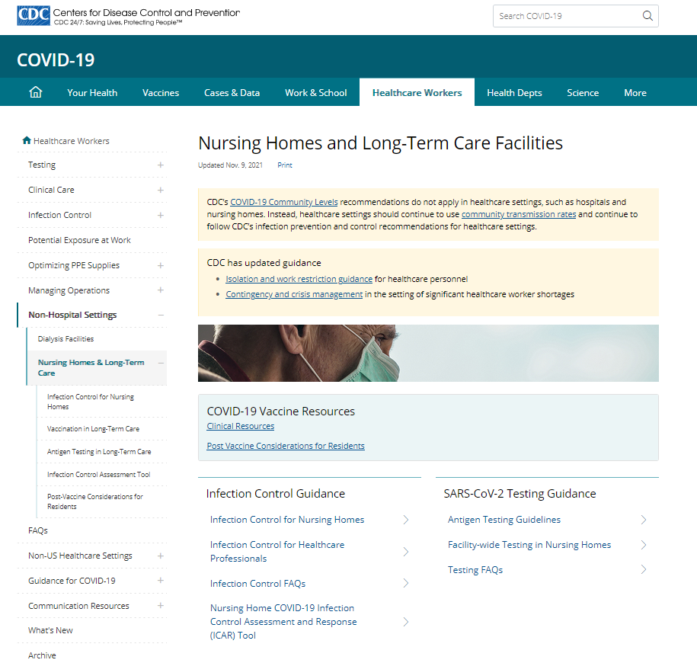


Keeping Up With Evidence, Guidance, Standards, Rules, and Regulations

Slide 21
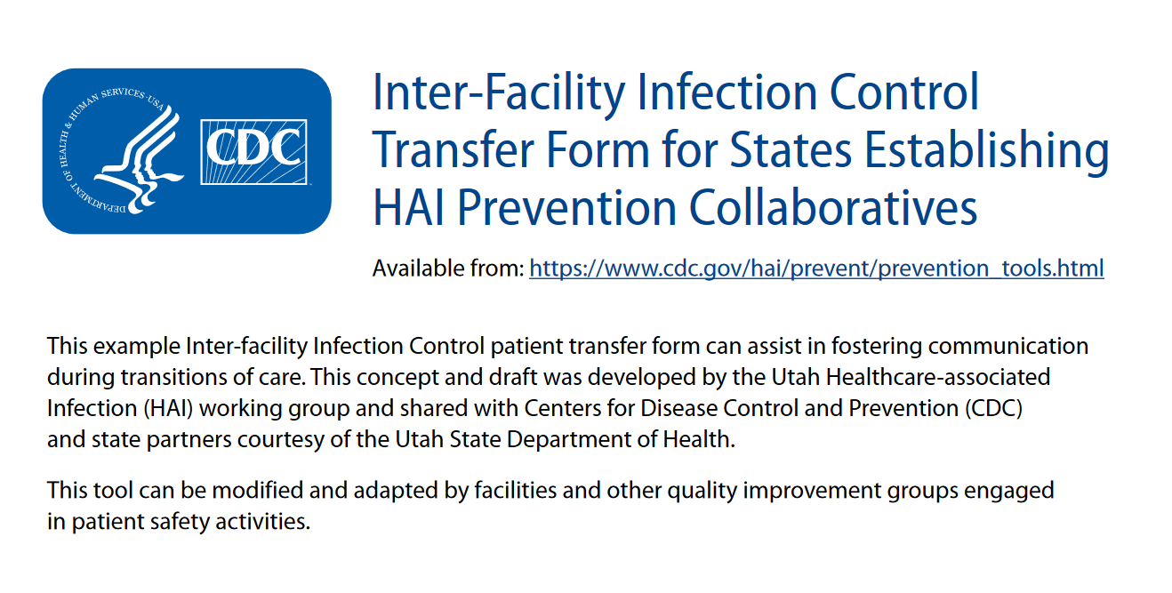

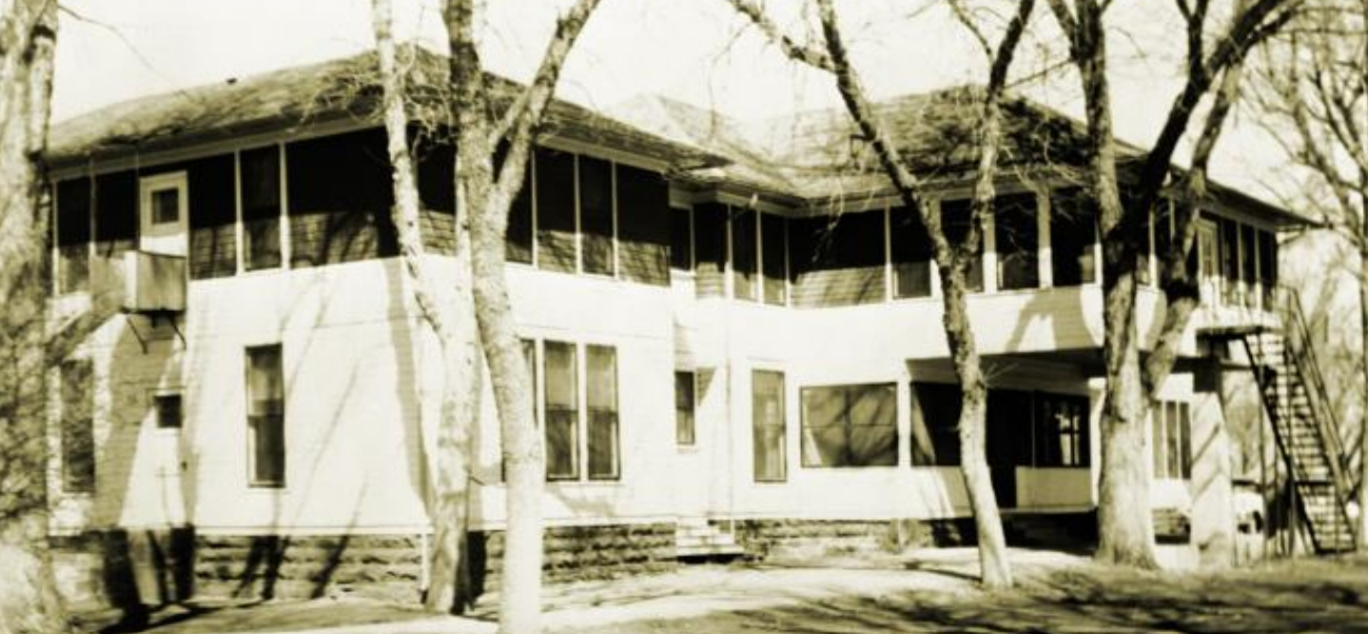

Interfacility Communication
https://www.cdc.gov/hai/pdfs/toolkits/Interfacility-IC-Transfer-Form-508.pdf
Photo: NIH
Photo: CDC
Photo: CDC

Slide 22

Where to start in your facility
Reality Based Planning?
Risk
Regulations
Realistic Threats
Realistic Plans
Communication!
Notes:
“No use fussing over something you can’t do anything about

Slide 23
Infection Prevention and Control in LTC is a Human issue, and needs to be dealt with within a biopsychosocial and spiritual framework
HUMAN
Spiritual
Psychological
Biological
Social

Slide 24

Burdsall High C’s of Infection Prevention and Control
Clean Hands and Gloves
Clean Clothes
Clean Equipment and Environment
Contained Drainage
Covered Wounds
Careful Assessment
Current Vaccinations
Careful Use of Antimicrobials
Collaborative Approach
Communication
© 2011
Photo Mommarazzi Images

Slide 25

What is Expected?
Clean
Contain
Careful Surveillance
Correctly Identify Issues
Correct Identified Issues

Slide 26

Addressing Infection Control Dogma
“We are just a social model.”
“I don’t believe in vaccines”

Slide 27

Vaccinating Staff Protects Residents
Effects of influenza vaccination of health-care workers on mortality of elderly people in long-term care: a randomised controlled trial
Interpretation Vaccination of health-care workers was associated with a substantial decrease in mortality among patients. However, virological surveillance showed no associated decrease in non-fatal influenza infection in patients
Carman, W. F., Elder, A. G., Wallace, L. A., McAulay, K., Walker, A., Murray, G. D., et al. (2000). Effects of influenza vaccination of health-care workers on mortality of elderly people in long-term care: A randomised controlled trial. The Lancet, 355(9198), 93-97

Slide 28
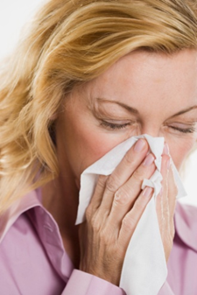
Employee Health, Screening, Vaccinations, and Presenteeism
Vaccinations and Screening are Critical
Ensure that employees do not stay at work when ill
Don’t force those under your supervision to participate in group activities if they are not feeling well
Notes:
If a person comes to work sick, they make their co-workers and other residents ill.
It is a policy of the Lutheran Home that everyone be healthy and free of infectious disease. It is also a state and federal regulation.
When the person that spread the germs comes back, everyone is working harder and working with less help
Staying home should also be a standard precaution that everyone should take to help prevent the spread of illness

Slide 29

Surveillance: Use as many current tools from LTC as you can to help gather information
24 Hour Reports
Verbal Report
Electronic Health Records
Secure E-mail
Pharmacy Antimicrobial Report
Laboratory Reports
CDC and other tracking maps (fluview, COVID-19 tracker)
NHSN or other public health sources

Slide 30

Surveillance requires that you look at what is really going on!

Slide 31
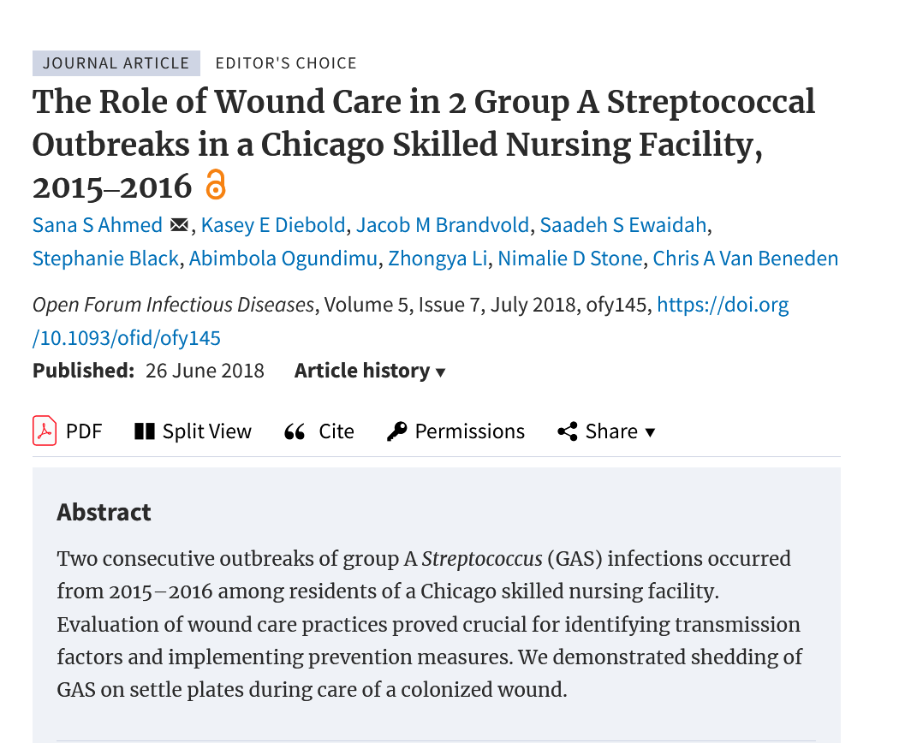
Wound Care
Who is providing wound care?
Wound Care accreditation and certification
Significant training, competency, and monitoring of both supplies and process
Outbreaks related to both resident and staff colonization/infection
Ahmed, et al, 2018 Open Forum Infectious Diseases Vol 5 Issue 7, July 2018, ofy145, https://doi.org/10.1093/ofid/ofy145
Notes:
Sana S Ahmed, Kasey E Diebold, Jacob M Brandvold, Saadeh S Ewaidah, Stephanie Black, Abimbola Ogundimu, Zhongya Li, Nimalie D Stone, Chris A Van Beneden, The Role of Wound Care in 2 Group A Streptococcal Outbreaks in a Chicago Skilled Nursing Facility, 2015‒2016, Open Forum Infectious Diseases, Volume 5, Issue 7, July 2018, ofy145, https://doi.org/10.1093/ofid/ofy145

Slide 32
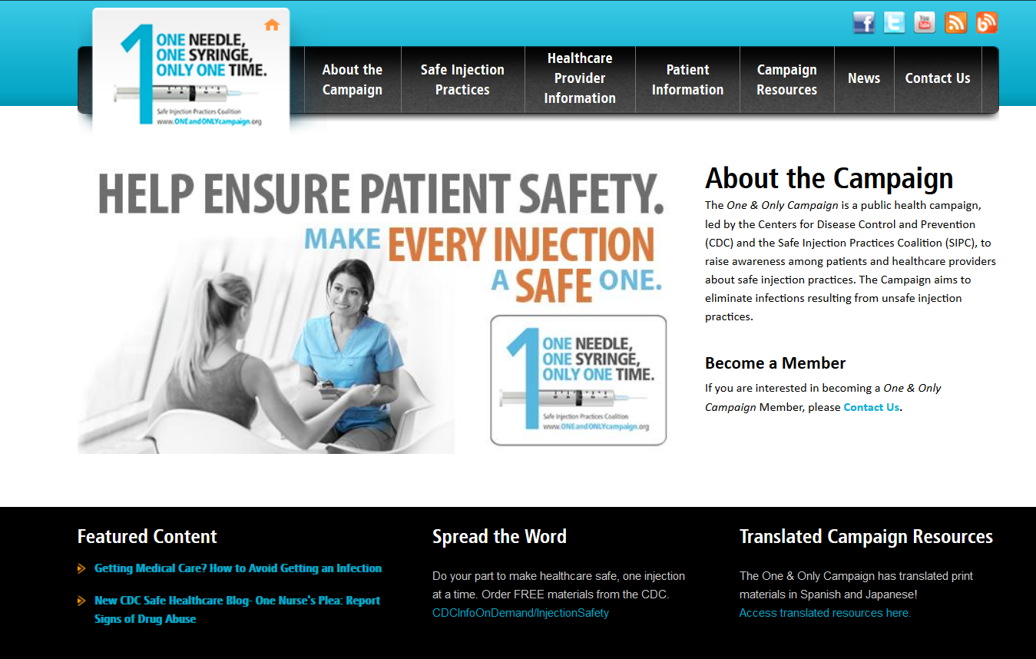
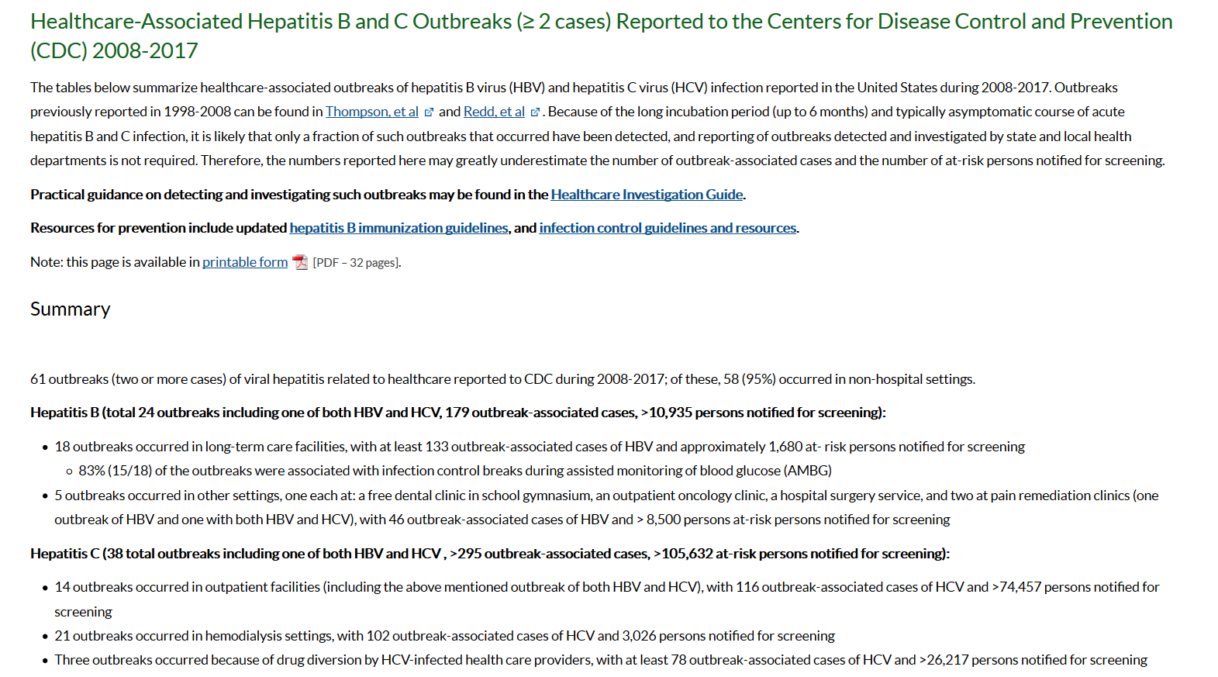
Injection Safety

Slide 33

Antibiotic use:
The sometimes solution, the continuing problem
“50% of antimicrobial (human) use is either unnecessary or inappropriate. Over 8 Billion spent on anti-infectives every year”
Dr. Loreen Herwaldt
August 16, 2006

Slide 34

Looking at What to Measure
Rates: This tells how fast the event is occurring
Incidence Rates: This is a measure of risk. The number of NEW cases/events that occur in a specific time in the population at risk
Proportions/percentages: This tells how much of the population is being affected by the event
Prevalence: The number of affected persons at any specific point in time

Slide 35

The pool is the overall prevalence
Incidence and Prevalence
New incidence cases admitted to LTC: Only control is not to admit
New Incidence from within LTC- Horizontal transmission: We can impact this with good infection prevention strategies
Notes:
Is this true??? Lets look at some of the research

Slide 36
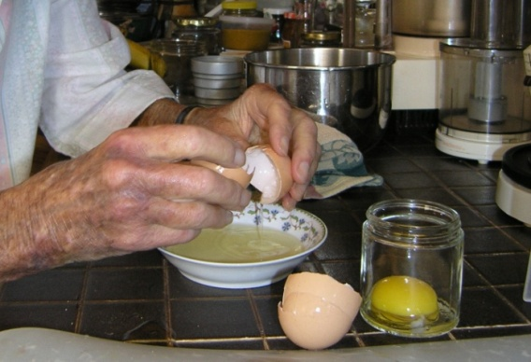
Hand Hygiene
Reported worldwide hand hygiene participation rates ranging from 5% to 89%
overall average reported to be 38.7%
Pittet, D., Allegranzi, B., & Boyce, J. (2009). The World Health Organization guidelines on hand hygiene in health care and their consensus recommendations • Infection Control and Hospital Epidemiology, 30(7), 611-622

Slide 37
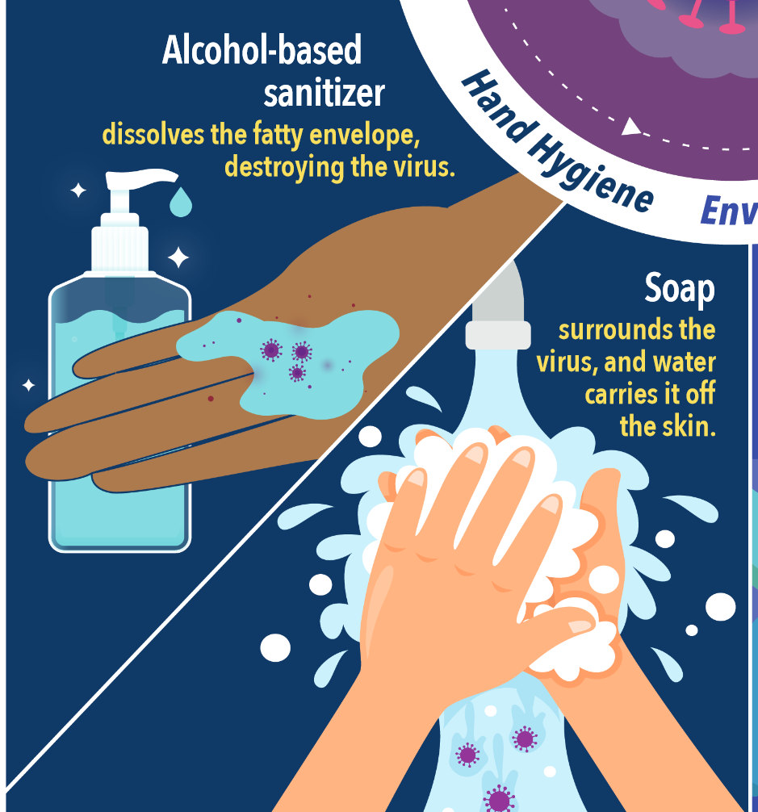
Based on the 'My 5 moments for Hand Hygiene', URL: http://www.who.int/gpsc/5may/background/5moments/en/index.html © World Health Organization 2009. All rights reserved.

Slide 38
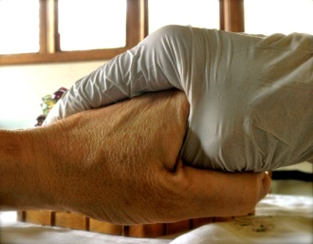
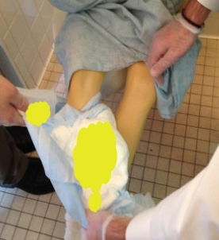
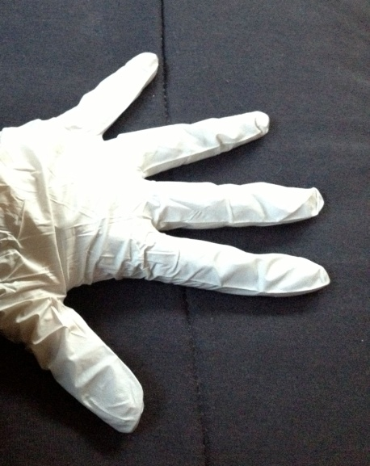
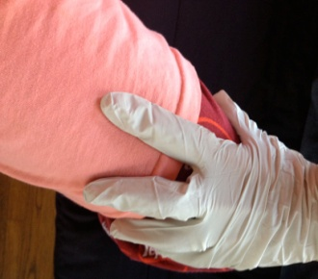

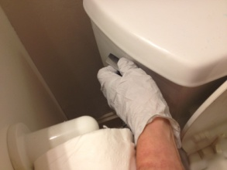
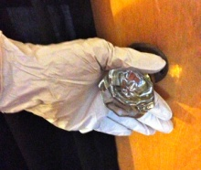
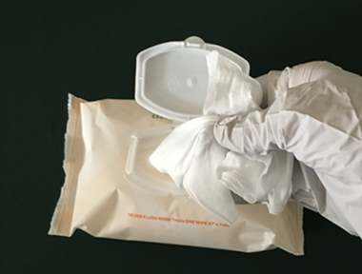
Patient
Healthcare Personnel Glove Use
Environment

Slide 39
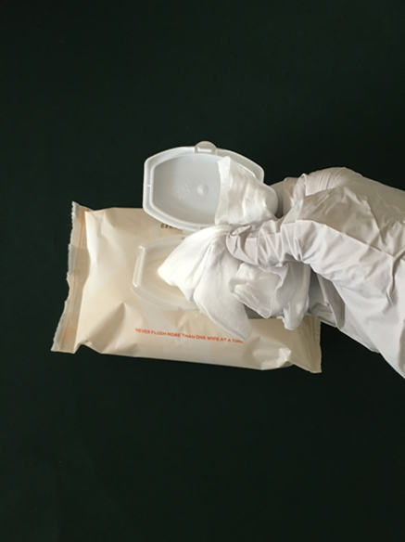
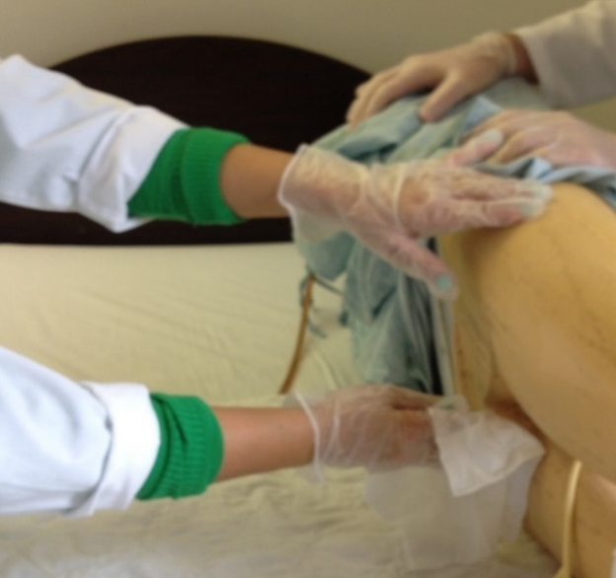
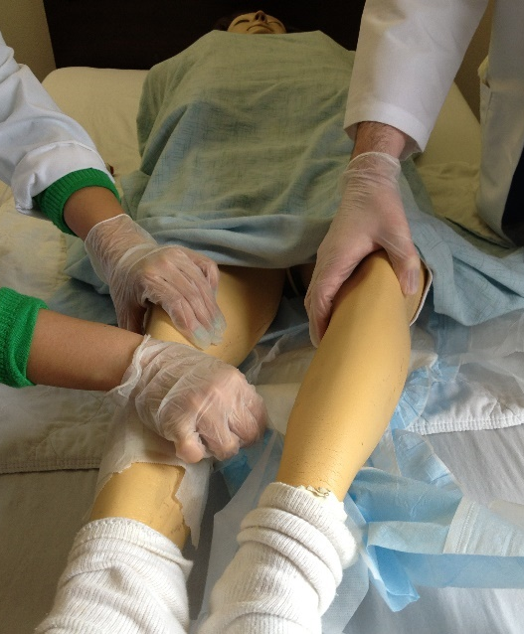
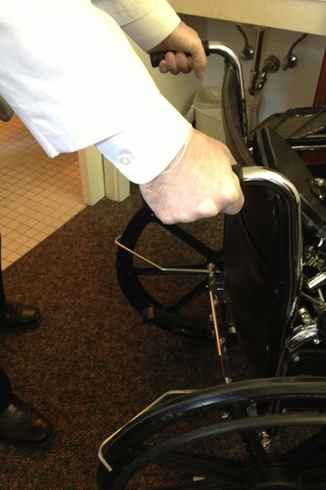
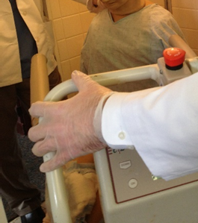
Two Indicators of Inappropriate CNA Glove Use in 74 Patient Care Events
782 Contaminated Touch Points
227 Failed or Misplaced Glove Changes
Burdsall et al., 2017 https://pubmed.ncbi.nlm.nih.gov/28863810/

Slide 40
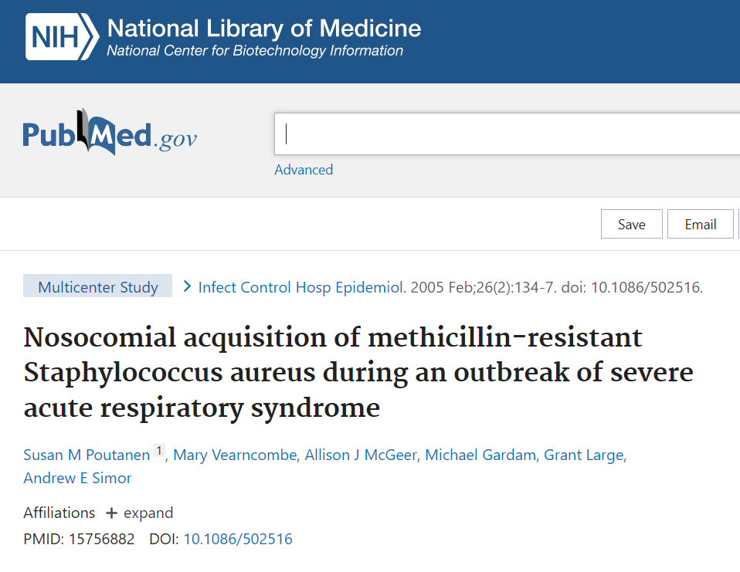
Lessons Learned from Toronto SARS outbreak in 2005
Conclusions: Inappropriate reuse of gloves and gowns and failure to wash hands between patients may have contributed to transmission of MRSA during the SARS outbreak.
Attention should be paid to training healthcare workers regarding the appropriate use of precautions as a means to protect themselves and patients.

Slide 41
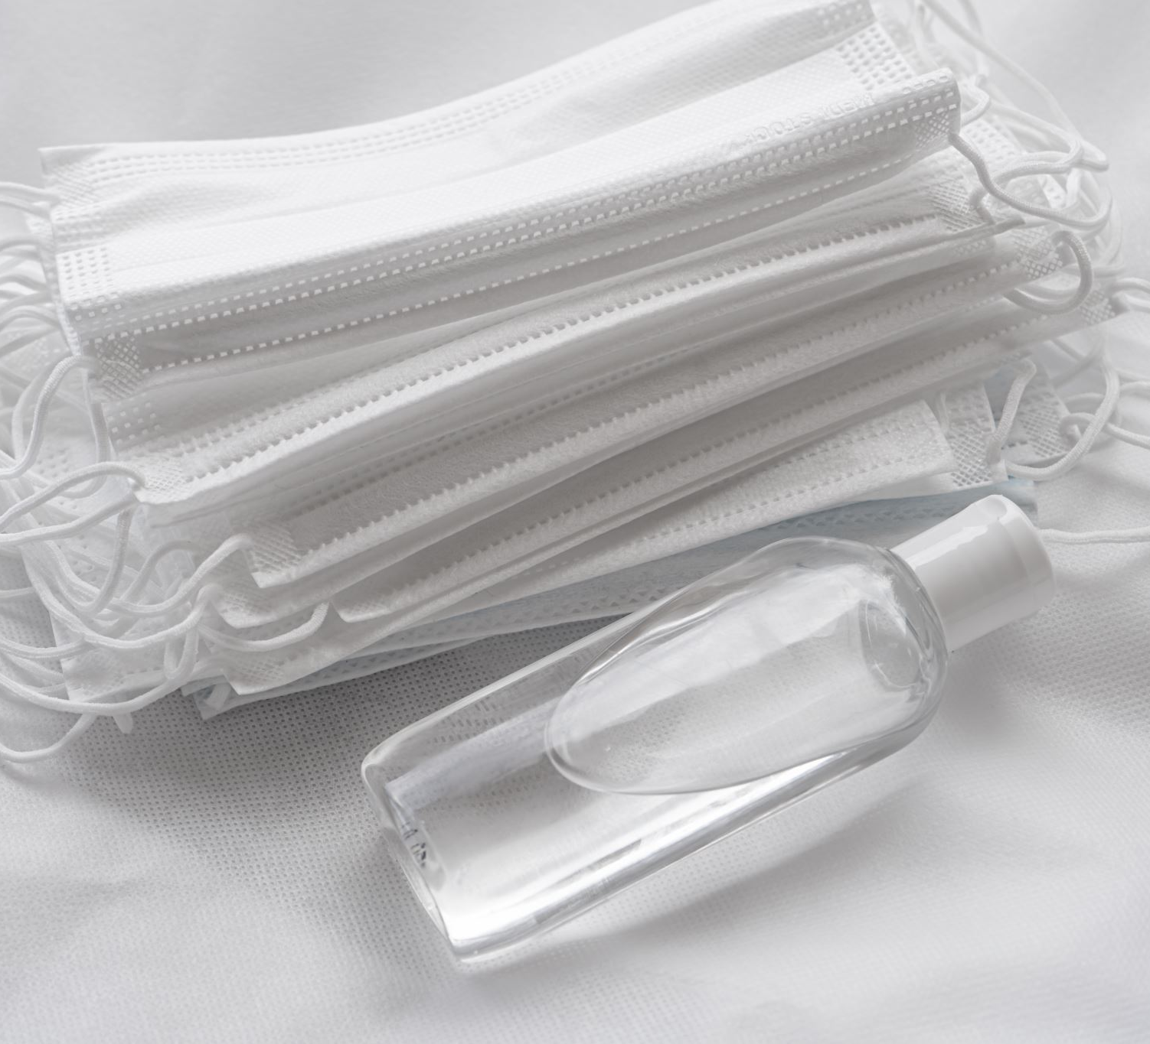
Standard and Transmission Based Precautions

Slide 42
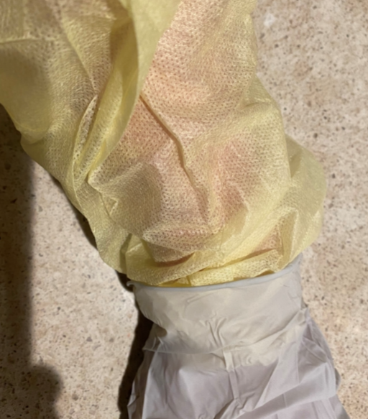
Isolation Gown

Slide 43

“Blood” (alcohol-based hand gel with red food dye)

Slide 44
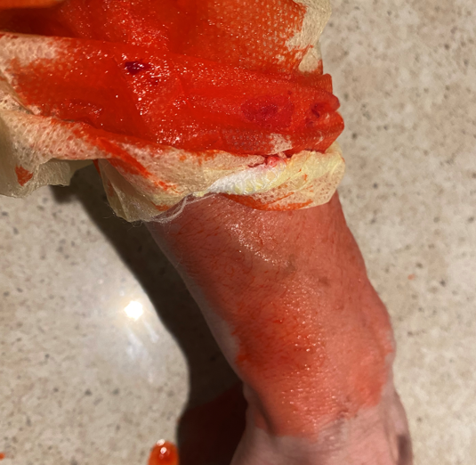
Strike Through…

Slide 45
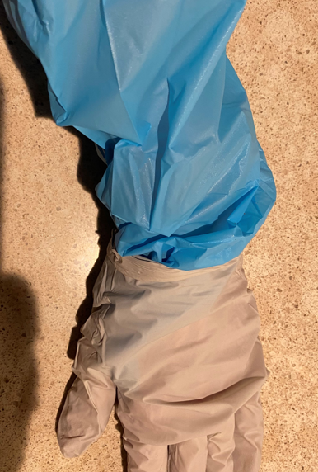
Fluid Resistant Gown

Slide 46

“Blood” (alcohol-based hand gel with red food dye)

Slide 47

Environmental Services and Related Areas
Environmental Cleaning and Disinfecting
Maintenance and Building
Plant Operations
Kitchen
Laundry

Slide 48

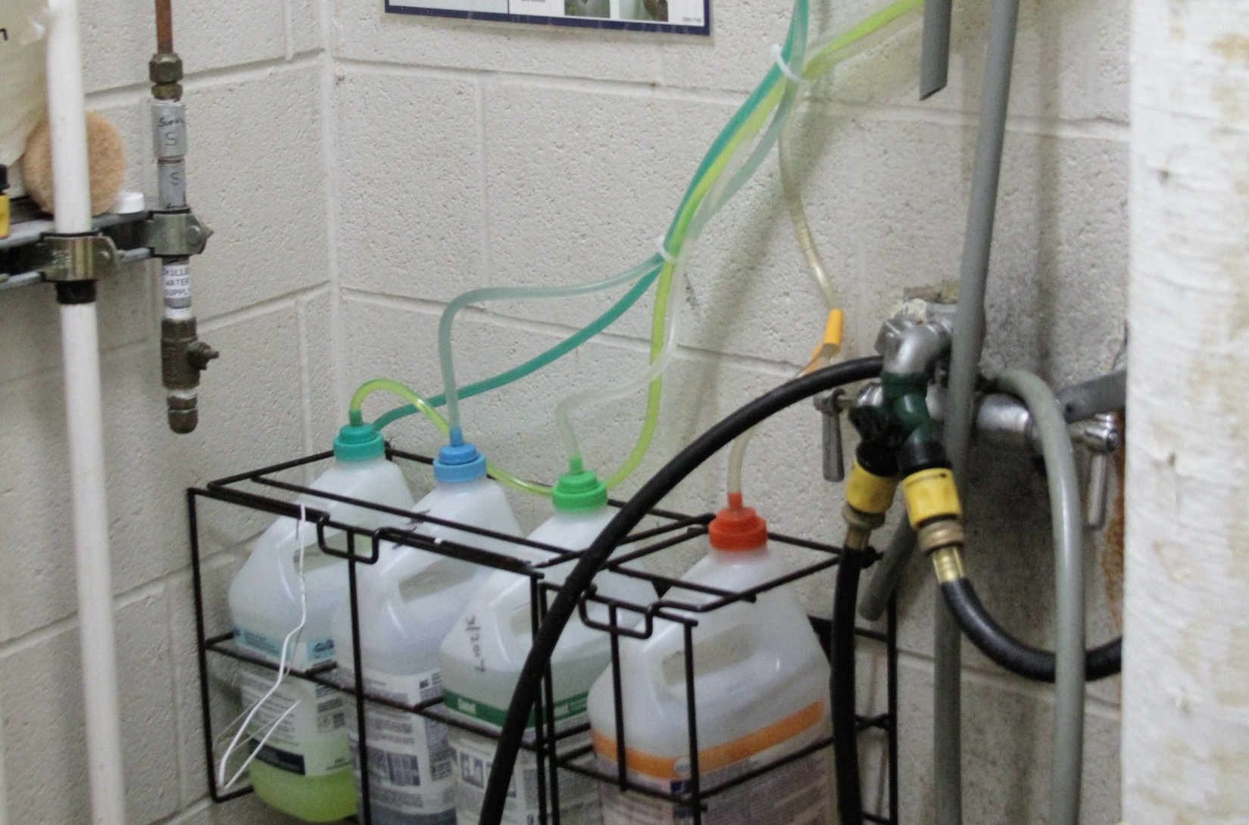
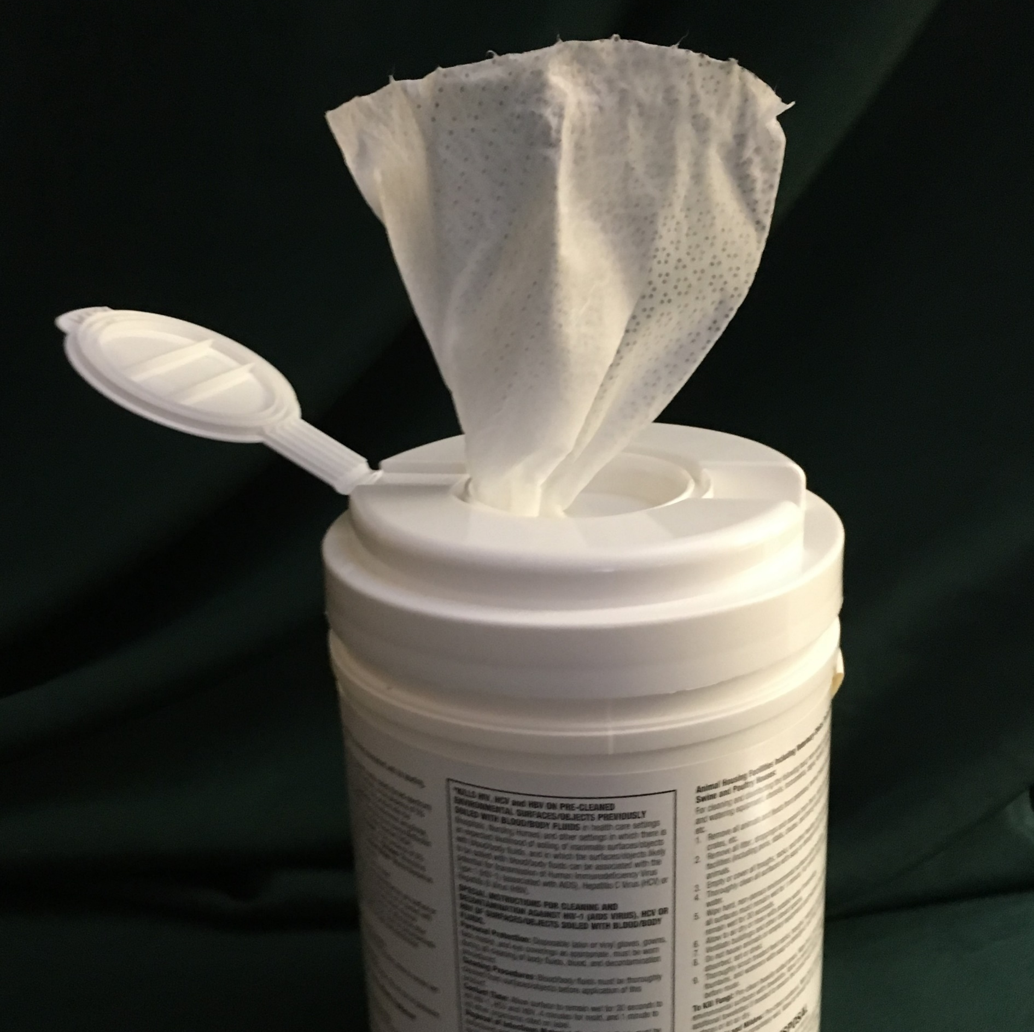

Environmental Cleaning and Disinfecting
Images: YAY Images, Mommarazzi Images © 2018

Slide 49
Equipment and Environment Not Cleaned
“Housekeeping’s Job”
“Nursing’s Job”

Slide 50

Image © Mommarazzi Images

Slide 51

Ideal Disinfectant
Nontoxic and non-irritating
Low toxicity rating
Not damage surfaces
Easy to use
Acceptable odor
Economical
One step cleaner / disinfectant
Rutala and Weber, 2014
Notes:
Rutala, W. A., & Weber, D. J. (2014). Selection of the ideal disinfectant. Infection Control & Hospital Epidemiology, 35(7), 855-865.

Slide 52

How to Read a Product Label
CDC Project Firstline Infographic
How to Read a Disinfectant Label (cdc.gov)
Notes:
It is not always easy to know the three R’s of using a cleaner disinfectant correctly. This is a CDC Project Firstline pictograph that clearly describes how to read a disinfectant label.

Slide 53

Preventing the Spread of Germs in Food
https://www.foodsafety.gov/
Hair net and hand hygiene
Keep hot foods hot and cold foods cold
Don’t touch ready to eat food with bare hands
Handle utensils properly
Keep things clean, neat and covered
In doubt? Throw it out!
Notes:
We all deal with food. It is important to remember these tips when handling food prepared for our residents, clients and patients.
It is important that all staff involved in direct resident contact maintain fingernails that are clean, neat, and trimmed.
dietary staff wear hair restraints (e.g., hairnet, hat, and/or beard restraint) to prevent their hair from contacting exposed food.
dietary staff keep jewelry to a minimum remove hand jewelry when handling food. These recommendations apply even when the use of gloves is employed

Slide 54

Healthcare Laundry
“…Develop and follow practices on handling, storing, processing, and transporting laundry so as to prevent the spread of infection.
The facility must monitor to ensure that the laundry practices are implemented, any deviations from practices must be identified, and corrective actions are put in place” CMS State Operations Manual page 784
https://www.cms.gov/medicare/provider-enrollment-and-certification/guidanceforlawsandregulations/downloads/appendix-pp-state-operations-manual.pdf

Slide 55
Detection, Isolation
Source Control / PPE
Screening and Surveillance
Surface Cleaning / Disinfecting
Image: Harper College
Ventilation/Air Filtration/Water Management
Hand Hygiene
Core Infection Prevention Practices
Notes:
Vaccination
Screening of all who enter the rehearsal space
Testing of unvaccinated and symptomatic persons
Hand hygiene (use of alcohol-based hand rub is preferred)
Face covering or mask (covering mouth and nose)
Physical distancing at least six feet between persons for unvaccinated persons
Instructional signage
Cleaning and disinfecting
Effective cohorting

Slide 56


Common Terms
Air Cleaner Certification Program Verifide Certification program developed by Association of Home Appliance Manufacturers (AHAM): Developed Clean Air Delivery Rate (CADR).
Portable air cleaners, also known as air purifiers or air sanitizers, are designed to filter the air in a single room or area.
Clean Air Delivery Rate (CADR) “CADR indicates the volume of filtered air an air cleaner delivers, with separate scores for tobacco smoke, pollen and dust. The higher the CADR number for each pollutant, the faster the unit filters the air.” (AHAM)
The higher the CADR, the more particles the air cleaner can filter and the larger the area it can serve. Most air cleaner packaging will tell you the largest size area or room it should be used in. Portable air cleaners often achieve a high CADR by using a high-efficiency particulate air (HEPA) filter.
High efficiency particulate air (HEPA) filter means a filter that is at least 99.97% efficient in removing monodisperse particles of 0.3 micrometers in diameter. All filters need regular replacement. If a filter is dirty and overloaded, it won’t work well.
https://www.epa.gov/indoor-air-quality-iaq/guide-air-cleaners-home
https://ahamverifide.org/ahams-air-filtration-standards/

Slide 57
Minium Efficiency Reporting Value (MERV Rating)
“Report a filter's ability to capture larger particles between 0.3 and 10 microns (µm)
MERV rating is helpful in comparing the performance of different filters
The rating is derived from a test method developed by the American Society of Heating, Refrigerating, and Air Conditioning Engineers (ASHRAE)
The higher the MERV rating the better the filter is at trapping specific types of particles.”
Recommended minimum MERV rating: MERV 13: Consult Heating, Ventilation, and Air Conditioning (HVAC) Professionals
For Infection Preventionist awareness only. HVAC professionals need to be part of the Infection Prevention and Control Team!
https://www.epa.gov/indoor-air-quality-iaq/what-merv-rating

Slide 58

https://www.cdc.gov/coronavirus/2019-ncov/prevent-getting-sick/improving-ventilation-in-buildings.html
Notes:
Efficacy of Portable Air Cleaners and Masking for Reducing Indoor Exposure to Simulated Exhaled SARS-CoV-2 Aerosols — United States, 2021
Weekly / July 9, 2021 / 70(27);972–976
On July 2, 2021, this report was posted online as an MMWR Early Release.
William G. Lindsley, PhD1; Raymond C. Derk, MS1; Jayme P. Coyle, PhD1; Stephen B. Martin Jr., PhD2; Kenneth R. Mead, PhD3; Francoise M. Blachere, MS1; Donald H. Beezhold, PhD1; John T. Brooks, MD4; Theresa Boots, MS1; John D. Noti, PhD1 (View author affiliations)

Slide 59


https://www.epa.gov/indoor-air-quality-iaq/guide-air-cleaners-home

Slide 60

Use of Engineering Controls and Indoor Air Quality
“When indoors, improving ventilation and increasing the number of times fresh or filtered air enters a room can help reduce viral particle concentrations and have been proven to decrease COVID-19 transmission. ‘The lower the concentration, the less likely viral particles can be inhaled into the lungs (potentially lowering the inhaled dose); contact the eyes, nose, and mouth; or fall out of the air to accumulate on surfaces,’ according to the CDC.
Improving ventilation practices and interventions can reduce the airborne concentrations and reduce the risk that residents, visitors, and health care personnel (HCP) come in contact with viral particles.”
https://dph.illinois.gov/covid19/community-guidance/long-term-care.html

Slide 61
IDPH Long Term Care Guidance rev. May 25, 2023
Approaches:
“Increasing the introduction of outdoor air.
Ensuring ventilation systems are operating properly as defined by ASHRAE Standard 62.1.
Optimizing the use of engineering controls to reduce or to eliminate exposures.
Exploring options to improve ventilation delivery and indoor air quality in all shared spaces. The higher number of air exchanges per hour will result in better results with respect to purging airborne contaminants. Refer to the CDC suggested options for Air Changes per Hour (ACH).
Using portable room air cleaners with a High Efficiency Particulate Air (HEPA) filter to enhance air cleaning. Air cleaners need to have the appropriate CADR (Clean Air Delivery Rate) rating for the room size.”

Slide 62

“To remove small particles, choose a portable air cleaner that has a high enough CADR for tobacco smoke, which represents the smallest particles.”
https://www.epa.gov/indoor-air-quality-iaq/guide-air-cleaners-home

Slide 63

Water Management Plan

Slide 64
Kanamori, Weber & Rutala (2016)
CDC
Water reservoirs
Bacteria
  Legionella and other Gram-negative bacteria
  Nontuberculous Mycobacteria
  Elizabethkingia meningoseptica (EKM)
  Elizabethkingia anopheles (EKA)
  Acinetobacter baumanii (also dry surfaces)
Occasional fungi and viruses
Waterborne outbreaks occurred in healthcare settings
Emergence of new reported reservoirs
  Electronic faucets (Pseudomonas aeruginosa and Legionella)
  Decorative water wall fountains (Legionella)
  Heater-cooler devices used in cardiac surgery (Mycobacterium chimaera)
Image: Picket Images
Notes:
Kanamori, H., Weber, D. J., & Rutala, W. A. (2016). Healthcare outbreaks associated with a water reservoir and infection prevention strategies. Clinical Infectious Diseases, 62(11), 1423-1435.Kanamori, H., Weber, D. J., & Rutala, W. A. (2016). Healthcare outbreaks associated with a water reservoir and infection prevention strategies. Clinical Infectious Diseases, 62(11), 1423-1435. Hospital water may serve as a reservoir of healthcare-associated pathogens, and contaminated water can lead to outbreaks and severe
infections. The clinical features of waterborne outbreaks and infections as well as prevention strategies and control measures are reviewed. The common waterborne pathogens were bacteria, including Legionella and other gram-negative bacteria, and nontuberculous mycobacteria, although fungi and viruses were occasionally described. These pathogens caused a variety of infections, including bacteremia and invasive and disseminated diseases, particularly among immunocompromised hosts and critically ill adults as well as neonates. Waterborne outbreaks occurred in healthcare settings with emergence of new reported reservoirs, including electronic faucets (Pseudomonas aeruginosa and Legionella), decorative water wall fountains (Legionella), and heater-cooler devices used in cardiac surgery (Mycobacterium chimaera). Advanced molecular techniques are useful for achieving a better understanding of reservoirs and transmission pathways of waterborne pathogens. Developing prevention strategies based on water reservoirs provides a practical approach for healthcare personnel. Keywords. waterborne outbreaks; healthcare-associated infections; water; outbreaks

Slide 65
What Do you do with the information??
Determine Risk
Share, Share, Share!

Slide 66

IDPH
Regional Infection Preventionists!!

Slide 67

Nell Griffin ngriffin@telligen.com
https://www.telligen.com/client-solutions/state/assessments/

Slide 68
New Interfacility Collaborative Education!!!!
Public Health
Long Term Care
Acute Care
9 Regional Roundtable Workshops
Collaboration!!Stay tuned!!

Slide 69
The Infection Preventionists Role is a Vital Link to Implementing the Core Measures of Infection Prevention!

