Slide 1
COVID-19 Testing in Long-Term Care
June 4, 2020

Slide 2
Housekeeping
All attendees in listen-only mode
Submit questions via Q&A pod to All Panelists
Slides and recording will be made available later

Slide 3
Agenda
Why test?
Preparing for results
LTCF definition(s)
Emergency rule
LTC Testing Memo
Process for obtaining testing
What to do after you receive results
Q & A
Slides and recording will be made available after the session.

Slide 4
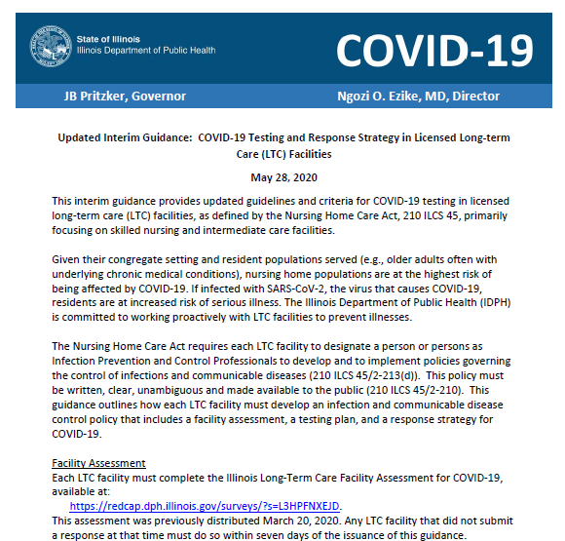
IDPH memos, 5/28/20: LTC testing and emergency rule

Slide 5
Why test in long-term care facilities?
IL
CDC
CMS
17,098 lab-confirmed COVID-19 cases and 2,744 deaths associated with long-term care facilities as of 5/29/20
Guides infection prevention and control measures
Recommended as factor for reopening nursing homes (QSO-20-30-NH; 5/18/20)
Cohorting and initiation of transmission-based precautions
Identifies asymptomatic cases
Exclusion of healthcare personnel
Refer to hyperlinks for source information.

Slide 6
Prepare, Prepare, Prepare!
Designate a COVID-19 unit
https://www.cdc.gov/coronavirus/2019-ncov/hcp/nursing-homes-responding.html
Understand the HCP return to work criteria
https://www.cdc.gov/coronavirus/2019-ncov/hcp/return-to-work.html
Plan for potential staffing shortages
https://www.cdc.gov/coronavirus/2019-ncov/hcp/mitigating-staff-shortages.html
Testing is only the beginning.
Facilities need to have a plan in place to act on the results.

Slide 7
LTCF definition(s)
Skilled Nursing Facilities
Intermediate Care Facilities
734
Intermediate Care/ Developmentally Disabled
Medically Complex / Developmentally Disabled
Sheltered Care Facility
Community Living Facility
Specialized Mental Health Rehabilitation Facility
+370
+500
Note: Figure does not include non-IDPH regulated facilities, eg. Supportive Living
Slide courtesy Rachel Whitcomb (BCG) and Avery Hart (IDPH consultant)
Assisted Living
Shared Housing

Slide 8
Emergency Rule, 77 Ill. Adm. Code 300
TITLE 77: PUBLIC HEALTH CHAPTER I: DEPARTMENT OF PUBLIC HEALTH SUBCHAPTER c: LONG-TERM CARE FACILITIES
PART 295 ASSISTED LIVING AND SHARED HOUSING ESTABLISHMENT CODE
PART 300 SKILLED NURSING AND INTERMEDIATE CARE FACILITIES CODE
PART 330 SHELTERED CARE FACILITIES CODE
PART 340 ILLINOIS VETERANS' HOMES CODE
PART 350 INTERMEDIATE CARE FOR THE DEVELOPMENTALLY DISABLED FACILITIES CODE
PART 370 COMMUNITY LIVING FACILITIES CODE
PART 380 SPECIALIZED MENTAL HEALTH REHABILITATION FACILITIES CODE
PART 390 MEDICALLY COMPLEX FOR THE DEVELOPMENTALLY DISABLED FACILITIES CODE
Where were changes made?
What facility types does this apply to?
For full text: https://www.dph.illinois.gov/covid19/governor-pritzkers-executive-orders-and-rules
Information current as of May 28, 2020

Slide 9
What does the emergency rule require?
Facilities must:
Add testing for infectious diseases to the facility’s infection control policies and procedures.
Comply with infection control recommendations provided by IDPH or their LHD
Test residents and staff when they have either an outbreak in the facility or when the chain of transmission is high and IDPH directs them to conduct testing. Test results must be reported to IDPH.
For full text: https://www.dph.illinois.gov/covid19/governor-pritzkers-executive-orders-and-rules

Slide 10
IDPH LTC Testing Memo
Must (i.e. required to):
Complete facility assessment
Create testing plan & response strategy
Test residents & staff
Skilled Nursing Facilities
Intermediate Care Facilities
Intermediate Care/ Developmentally Disabled
Medically Complex / Developmentally Disabled
Sheltered Care Facility
Community Living Facility
Specialized Mental Health Rehabilitation Facility
Should complete above items. Can use same REDCap links, except Assisted Living was sent a separate assessment link.
Assisted Living
Shared Housing
Note: Figure does not include non-IDPH regulated facilities, eg. Supportive Living
Slide adapted from Rachel Whitcomb (BCG) and Avery Hart (IDPH consultant)

Slide 11
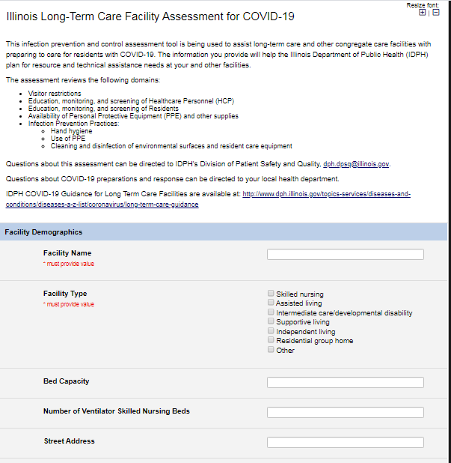
Facility Infection Control Assessment
Each SNF/ICF must complete the assessment at https://redcap.dph.illinois.gov/surveys/?s=L3HPFNXEJD
Previously distributed on March 20, 2020. No need to resubmit if you already filled out. There was an option to receive a confirmation email upon survey submission. If you think you submitted before, please check your email for this verification
Otherwise, must complete within 7 days of memo release

Slide 12
Required Testing Plan and Response Strategy
Written COVID-19 testing plan and response strategy within 14 days of the issuance of the memo. Must be made available to IDPH upon request.
Must specify the necessary personnel, and the required training or experience of the personnel, to properly care for the number and types of residents served by the facility, including the personnel necessary to execute the COVID-19 testing plan.
What test type is acceptable?
PCR testing (FDA Emergency Use Authorized COVID-19 molecular assay for detection of SARS-CoV-2 RNA)

Slide 13
Testing Plan (cont)
The testing plan shall identify the ordering physician, method of obtaining consents for the tests, and the criteria and frequency for testing residents and staff.
Every COVID-19 testing plan shall identify by name a dedicated laboratory contracted or otherwise engaged to provide COVID-19 clinical testing services according to the volume and frequency identified in the testing plan.
IDPH can advise LTC facilities regarding laboratories with available capacity.

Slide 14
How can my facility get tested?

Slide 15
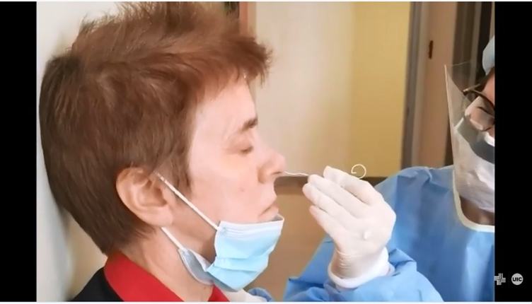
Onsite Training for Specimen Collection
Upon request, and subject to availability, IDPH can provide onsite training for proper specimen collection or other assistance as necessary.
This can be requested via https://redcap.dph.illinois.gov/surveys/?s=8TYYKCETCX.
Notes:
Favorite Nurses Staffing, currently contracted through IEMA through mid-June

Slide 16
Testing for LTCFs with no COVID-19 cases in last 28 days
IDPH can refer facilities with no COVID-19 cases in the last 28 days to a partner laboratory (currently Quest). Facilities may request this referral here: https://redcap.dph.illinois.gov/surveys/?s=8TYYKCETCX.
Facilities should notify LHD of upcoming plans for testing. LHD can help facilities prepare for or respond to results.

Slide 17
Testing for LTCFs with outbreaks or identify their 1st case
IDPH Laboratory can provide test kits and perform testing
As part of outbreak response, facilities should discuss testing plans and arrangements with their local health department
Then they can sign up for testing through the same form: https://redcap.dph.illinois.gov/surveys/?s=8TYYKCETCX
Once the outbreak is over, the facility must identify a contracted or engaged laboratory to continue to provide COVID-19 clinical testing services according to their testing plan

Slide 18
Process for testing through a referred or IDPH laboratory
An IDPH representative will call you to arrange for testing and/or onsite specimen collection support, if requested.
If you requested testing, your referred laboratory or IDPH representative will arrange for shipment of supplies, discuss specimen collection and transport, and set up a facility account and contract.
Billing for either Quest or IDPH laboratories will be handled in the same manner. They will obtain insurance information for test recipients to bill for services. Residents and staff without insurance will still be able to be tested, with services supported by HFS/CARES Act.

Slide 19
Process for testing through a referred or IDPH laboratory
Facility obtains consent from residents (or their representatives) and staff to be swabbed prior to date of testing. Facility also prepares or compiles other supplies needed for specimen collection (e.g., specimen labels, test requisition forms, PPE, etc).
Transport media may require refrigeration – ensure you have space to store supplies!
Facility should prepare for the results. For example, ensure that a dedicated COVID-19 unit with dedicated staff are in place, prepare for potential health care worker shortages, and understand the return to work criteria.
Once facility receives test kits, they can conduct specimen collection (or on designated date if onsite assistance was requested) and submit samples to their designated laboratory.
Your referred laboratory will conduct testing and report results to the facility and IDPH.

Slide 20
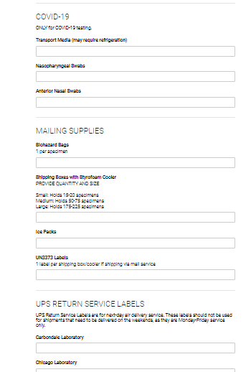
Testing through the IDPH Laboratory
Online order form: Facilities must obtain an outbreak or INEDSS number to order supplies
Don’t forget to order shipping supplies
Prefer that facilities drop off or courier specimens to an IDPH Lab to ensure sample integrity
If not possible, alternate arrangements can be explored
Top reasons for sample rejection: samples not kept cold (2-8⁰C) or not delivered to lab within 72 hours of collection
Test requisition form: Each specimen must be submitted with this form

Slide 21
Training Materials for Specimen Collection and Packaging
IDPH-produced video [in post-production]
IDPH Lab’s 17 steps for collection
PowerPoint slides with step-by-step instruction
Resources to be housed on upcoming IDPH LTC testing website

Slide 22
What to do with positive results
Report to LHD and CDC/NHSN (if required)
Implement infection control measures, plan for subsequent testing
Notify residents, families/representatives, and staff (see CMS requirements)
Notes:
Appropriate infection control actions (e.g., cohorting, transmission-based precautions, exclusion of workers)
Plan for subsequent testing

Slide 23
Refer to CDC guidance – Retesting if positive cases
Immediately test any resident or HCP who subsequently develops fever or symptoms consistent with COVID-19
Continue repeat testing of all previously negative residents (e.g., once a week) until the testing identifies no new cases of COVID-19 among residents or HCP over at least 14 days since the most recent positive result.
If test capacity is limited, CDC suggests directing repeat rounds of testing to residents who leave and return to the facility (e.g., for outpatient dialysis) or have known exposure to a case (e.g., roommates of cases or those cared for by a known positive HCP).
For large facilities with limited test capacity, testing all residents on affected units could be considered, especially if facility-wide serial testing demonstrates no transmission beyond a limited number of units.
https://www.cdc.gov/coronavirus/2019-ncov/hcp/nursing-homes-testing.html

Slide 24
Refer to CDC guidance – Retesting if positive cases (cont)
Continue repeat testing of all previously negative HCP (e.g., at least once a week, consider more frequent testing in settings where community incidence is high) until the testing identifies no new cases of COVID-19 among residents or HCP over at least 14 days since the most recent positive result.
If testing capacity is limited, CDC suggests directing repeat HCP testing to HCP who work at other facilities where there are known COVID-19 cases.
https://www.cdc.gov/coronavirus/2019-ncov/hcp/nursing-homes-testing.html

Slide 25
What to do with all negative results
This is great news! But remember that this only provides a snapshot of COVID-19 status on the day swabbing occurred
Continue with infection prevention and control measures (e.g., monitoring hand hygiene adherence/PPE use and screening residents and staff for symptoms)
Plan for subsequent testing per your facility’s testing plan

Slide 26
Points for consideration when determining testing frequency if no cases
CMS QSO-20-30-NH has recommendations for nursing homes
From their FAQ:
9. How often should a nursing home test its staff?
All staff should receive a baseline test, and continue to be tested weekly
(Note from memo: “State and local leaders may adjust the requirement for weekly testing of staff based on data about the circulation of the virus in their community”)
10. How often should a nursing home test its residents?
Nursing homes should have a comprehensive plan for testing. All residents should receive a single baseline test for COVID-19. Also, all residents should be tested upon identification of an individual with symptoms consistent with COVID-19 or if an employee or staff member tested positive for COVID-19.

Slide 27
Points for consideration when determining testing frequency if no cases
CDC: “Considerations for time intervals between testing include concern for ongoing transmission and logistics of repeat large scale testing.”
Incidence of COVID-19 in community
Lab turnaround time and capacity
Testing should not supersede infection prevention and control actions.

Slide 28
What are the deadlines?
Facility assessment
Testing plan and response strategy
Facility-wide baseline testing
7 days of memo release
14 days of memo release
No required deadline
If 1st case/ new outbreak/ outbreak with rapid increase in cases or many deaths, test as soon as possible
For other situations, consider CMS guidance for reopening nursing homes, whether facility has ever had cases, low vs high incidence area

Slide 29
FAQ
Q: Will residents and staff be charged for testing?
A: Please refer to the HFS provider notice, “COVID-19 Testing is Free to Illinois Residents”, 5/18/20.
If they are insured, insurance will be billed; there should be no copays, deductibles, etc. If they are uninsured, HFS Uninsured COVID-19 Testing Program will support testing.
https://www.illinois.gov/hfs/MedicalProviders/notices/Pages/prn200518a.aspx

Slide 30
Staff refusals
Staff members have a legal right to refuse testing. But staff who refuse to be tested may be infected and so may transmit COVID-19 to residents and other staff.
Facility administration may develop human resource policies to address staff refusals.
Facilities may consider whether testing will be a condition for continued employment.
If facility policy does not require staff testing, then the facility should consider what measures are needed to protect residents from risk of exposure to a staff member with undetermined COVID-19 status.

Slide 31
Resident consent and refusal
Residents would be covered for testing by the general consent that they typically would sign on entry.
Residents, or their guardians or legal surrogates, have a legal right to refuse testing, as an exception to the general consent.
If no general consent for a resident is on file with the facility, verbal, informed consent must be obtained prior to testing and documented in the resident’s chart.

Slide 32
Questions
Submit questions via Q&A pod to All Panelists
Friday Brief Updates and Open Q&A (1-2 pm):
Friday June 5th https://illinois.webex.com/illinois/onstage/g.php?MTID=e93324db3f5686b96980cbdcc42059012
LTC testing mailbox: dph.ltctesting@illinois.gov

